Slide 1
Thank you, all TGSW 2017 Session 8-8 speakers organizers participants
In particular those who have travelled
long ways from abroad.
F. Ukegawa 2017/9/26

Slide 2
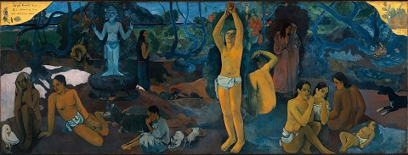
Particle, Nuclear, and Astro- physics from a grand view of the History of the Universe
“Where Do We Come From? What Are We?
Where Are We Going?”
Paul Gauguin 1897
Seems like a daunting task to me. Not sure if we ever achieve that.
2017/9/26

Slide 3
Re-organization as of Oct 1, 2017
From CiRfSE
To TCHoU
Inaugural symposium planned for March 2018.
Hope to see you all again then.

