Slide 1
Silicon Detectors
K. Hara
University of Tsukuba
Faculty of Pure and Applied Sciences
EDIT2013 March 12-22,2013

Slide 2
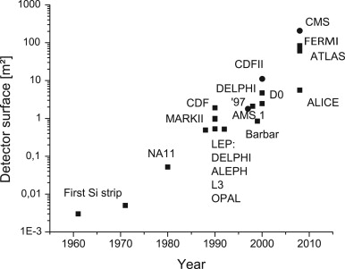
Applications of Si detectors
whole tracking
F. Hartmann (2009)
tracking
HEP
VLSI
vertexing
UA2
First transistor invented 1947 (Shockley, Bardeen, Brattain)
Ge(Si ) diodes used for particle detection in 50s
follows a la Moore’s law

Slide 3
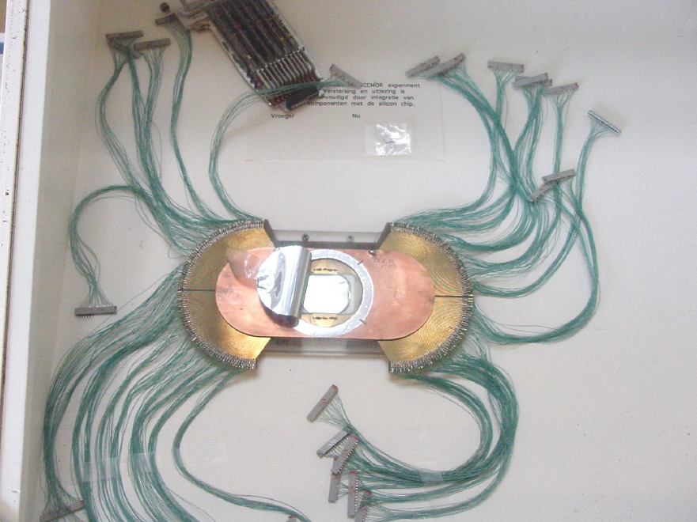
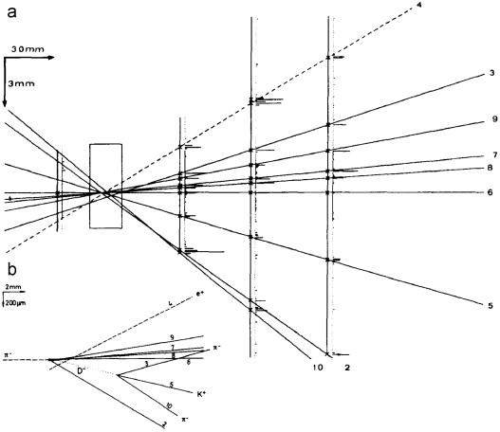
NA11 (CERN)
First operational Si strip detector used in experiment
First observation of Ds
size:24x36mm
• Aim: measure lifetime of charm
quarks (decay length cτ~30 μm)
⇒ spatial resolution better 10μm required
24 x 36 mm² size per chip
1200 strips, 20 μm pitch
240 read-out strips
250-500 μm thick bulk material
⇒ Resolution of 4.5 μm
D⁻→K⁺π⁻π⁻

Slide 4
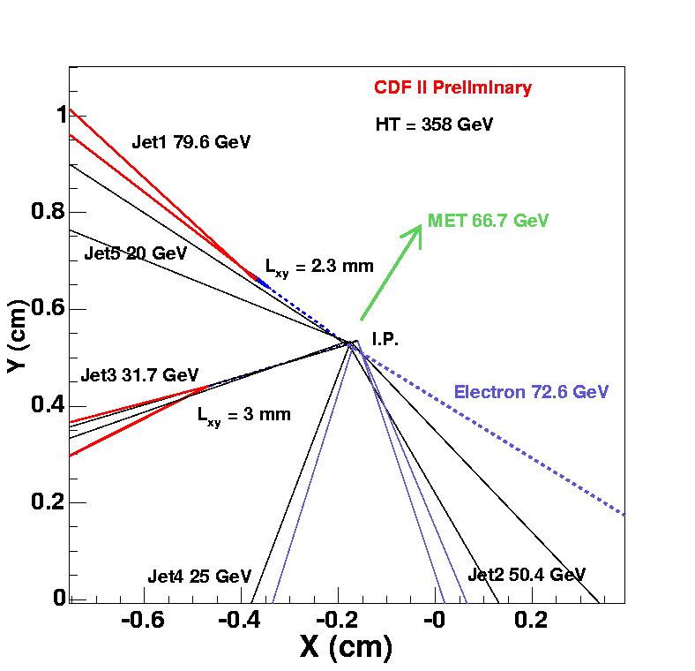
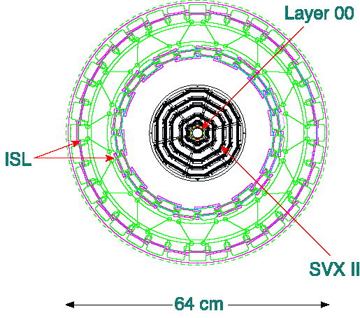
Vertexing at colliders
11cm
->j₁
B-hadron ->j₃
B-hadron lifetime: ~2ps
qq->j₂j₄
decay length~ γβcτ=p/m*0.3[mm]
ev

Slide 5
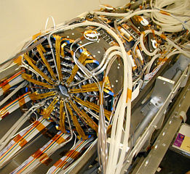
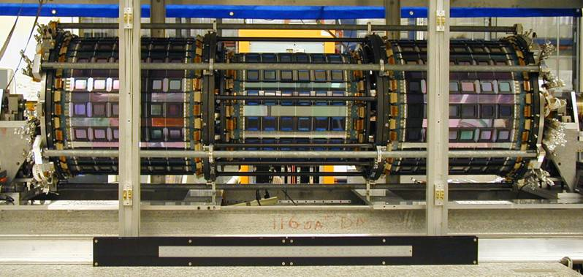
CDF Silicon Tracker
Vertexing (L0+SVX2: 1SS+5DS)
22cm
CDF extended Si coverage to tracking for the momentum measurement, outside the vertexing region.
Si detector required for high particle density
Intermediate Silicon Layers (2 DS)
64cm

Slide 6
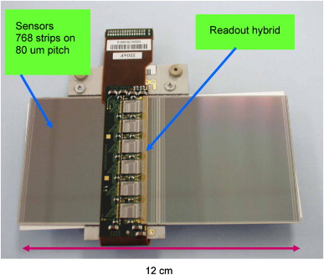
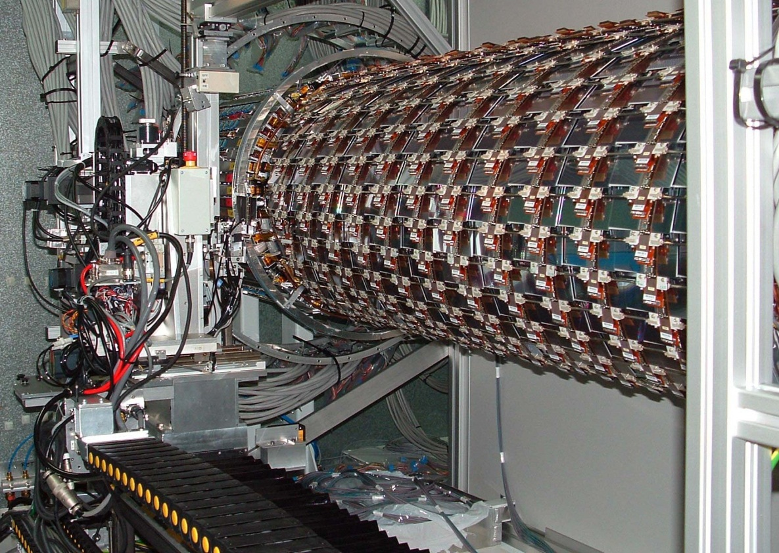
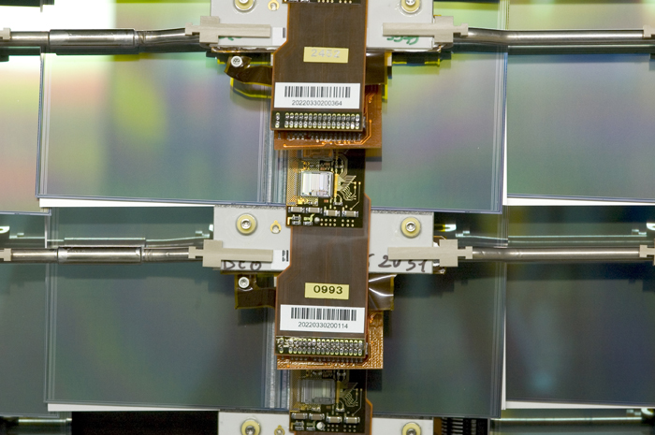
ATLAS SCT
~2000 Barrel modules
~2000 EC modules
Robotic mounting

Slide 7
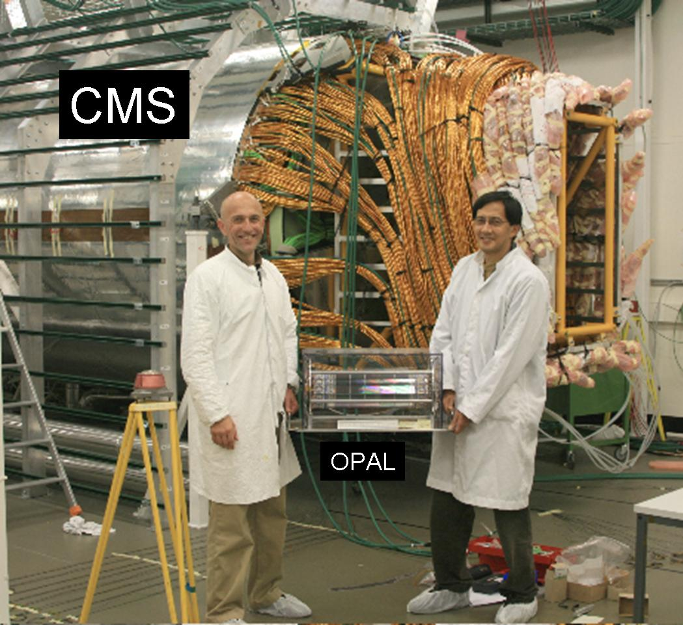
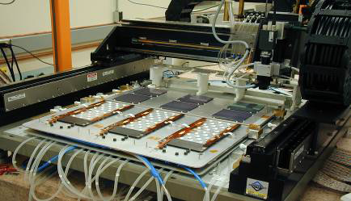
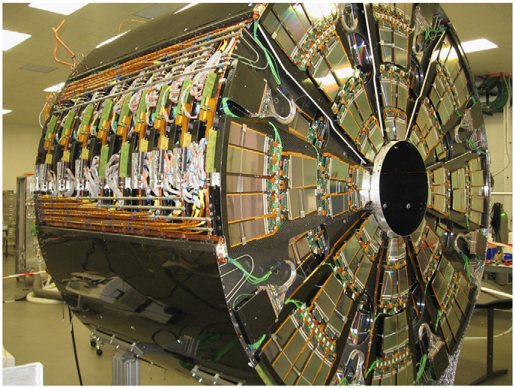
Largest System: CMS
automated module assembly
endcap

Slide 8
Lecture outline
Why silicon?
Semiconductor
Diode p-n junction
Planar Si detector
Full depletion
IV, CV
Signal processing example
Radiation resistance
Relatives of planar microstrip sensors
Work on Si detector: Practical notice

Slide 9
Advantages of Si Detectors
cons
Industrial CMOS process adoptable
micron order manufacturing is possible
rapid development of technology (reduction of cost, but still high/area)
(easy) integration with readout electronics for identical materials used
Low ionization energy & high density (solid)
3.67eV/e-h compared to gas detectors (Xe/Ar:22/26 eV/e-ion), scintillator (100eV/γ )
thin device possible with small diffusion effect, resulting in σx<10μm achievable
self-sustainable structure (compact detector)
High intrinsic radiation hardness
applicable in HEP experiments and for X-ray image sensors

Slide 10
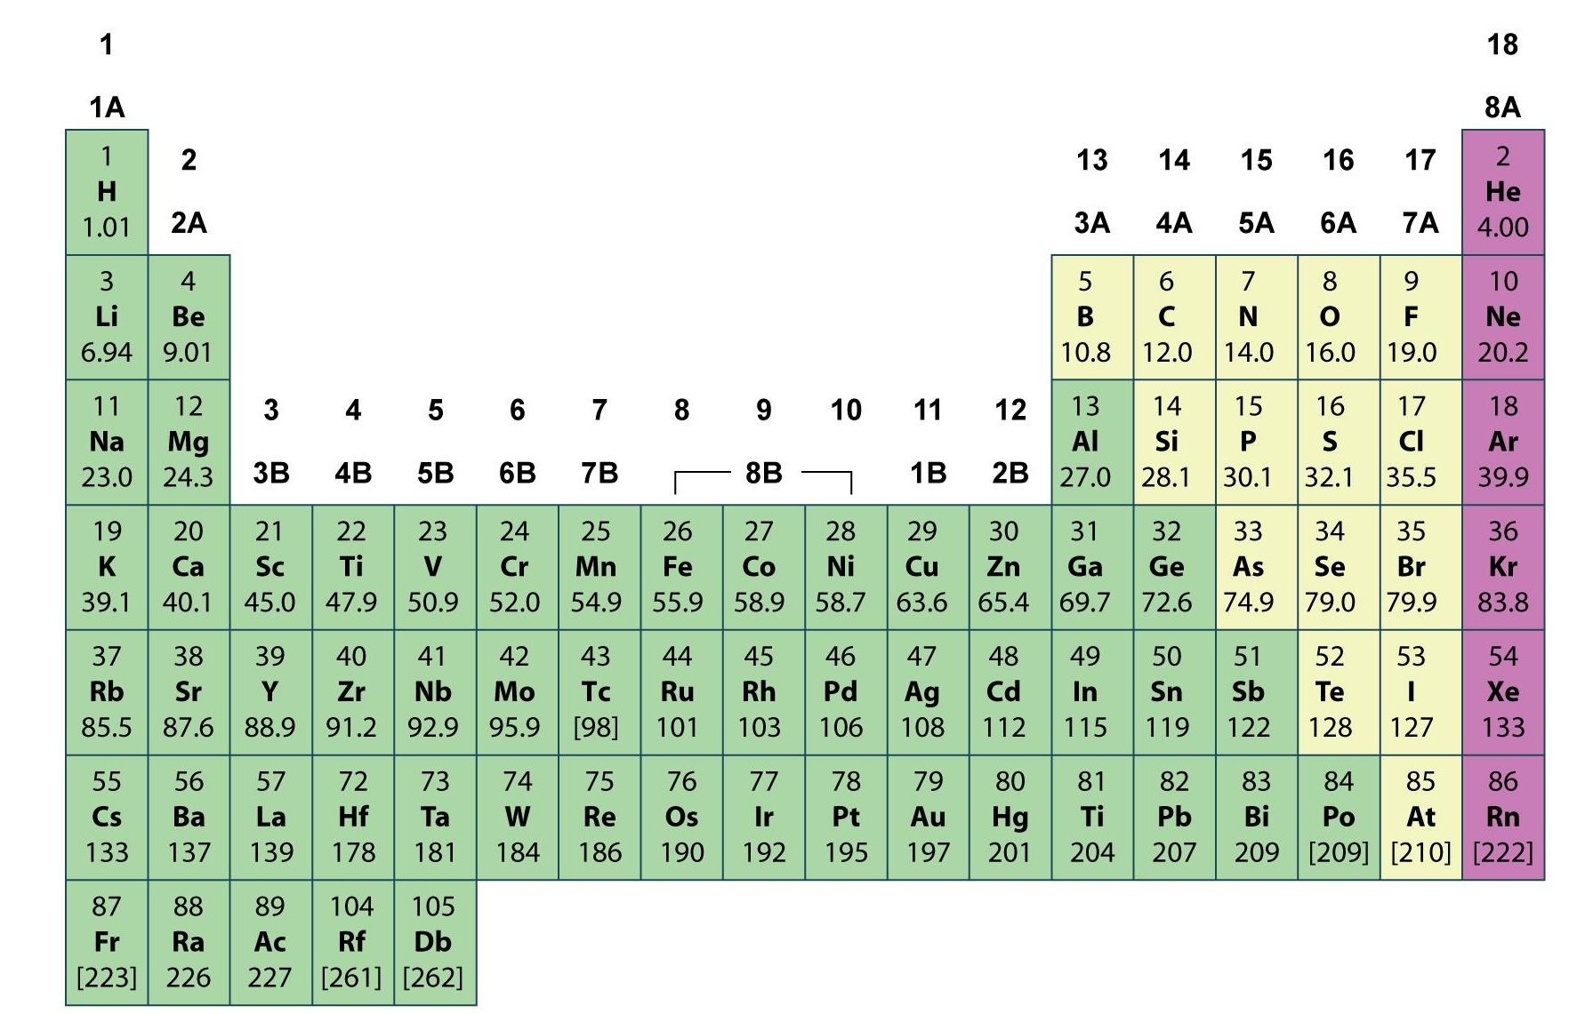
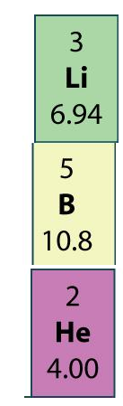
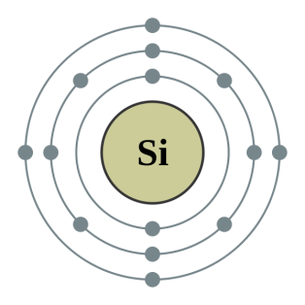
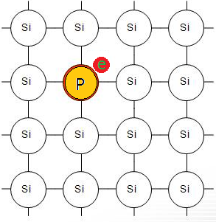
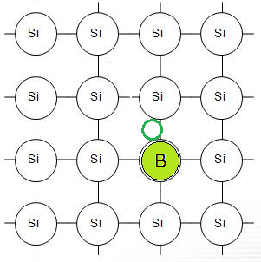
Why Silicon?
metal
non-metal
noble gas
group
/family
Silicon is 2nd most abundant element on Earth
Silicon semiconductor is realized by:
appropriate band gap (1.1eV)
excellent insulator SiO₂ (~10⁷ V/cm)
good neighbors B (as donor) and P (as acceptor)
Periodic Table
hole
In a pure silicon crystal,
V in IV: electron excess
III in IV: electron deficit
4 bonding electrons
n-type silicon
p-type silicon

Slide 11
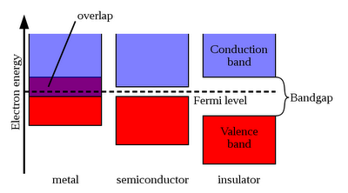
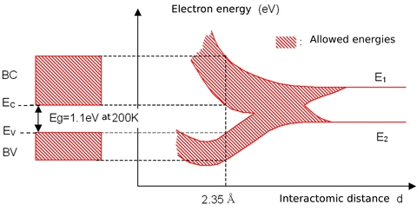


“appropriate” band-gap
band: when single atoms combine, outer quantum states merge, providing a large number of energy levels for electrons to take.
electrons in conduction band: free
electrons in valence band: tied to atoms
μ: highest energy
level at T=0K
B.G.>9eV(SiO₂)
B.G.～1eV
Interatomic distance
typical semiconductor ‘s band gap:
Si(1.1eV) Ge(0.67eV)
At room temperature, “small” number of free electrons in C.B. in semiconductor
probability of finding electron in state ε_{i}:
no intensive cooling required
or
~10⁻¹⁰ (Δε_{i}:1.1eV)
kT=0.026eV @RT
(Fermi-Dirac distri.)
(Maxwell-Boltzmann distr.)
semiconductor devices utilize them as signal carries

Slide 12
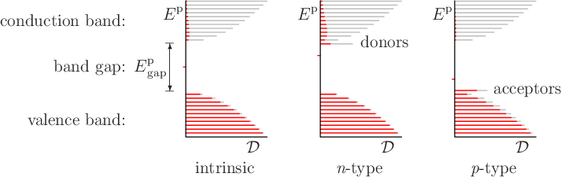
Doped Semiconductor
states occupied
0.045eV
un-occupied
1.1eV
:state density
intrinsic : semi-conductive by thermal excitation
most of donors (electrons) => more electrons in C.B.
acceptors (holes) => more holes in V.B.@RT
more conductive than intrinsic
n,p: density of electron, hole carriers
N_{A},N_{D}: density of acceptor, donor atoms
Notation i: intrinsic (does not appear in usual application)
n,p (n⁻,p⁻): lightly doped semiconductor (main sensor part)
n⁺,p⁺: heavily doped semiconductor (used as “electrode conductor”)

Slide 13
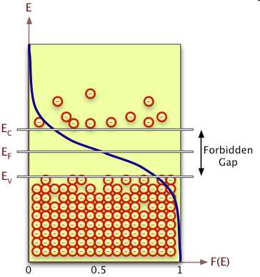
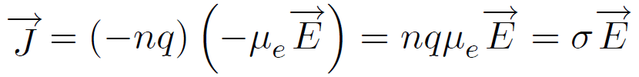



Carrier concentration
In intrinsic silicon
effective number of states in C.B.
E
state density in CB
F(E)
carrier density
g_{C}(E)
Resistivity:
330 kΩcm @T=300K
/cm³
@T=300K
In doped silicon
Law of mass action : When p increased to Np_{i} by doping, part of them recombine with n_{i} such that n reduced to n_{i} /N
: neutrality
N_{A}: acceptor atoms are negatively charged
In n-type, n>>p , N_{A}~0, N_{D}>p
For (majority) n~N_{D}~10¹²/cm³,
(minority) p~2x10²⁰/10¹²=2x10⁸/cm³
high ρ Si for typical n-bulk sensor
@T=300K

Slide 14
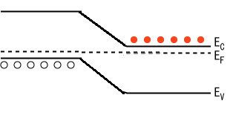
Diode (pn-junction)
p-type
n-type
e-h recombine
(thermal diffusion)
+
n
+
-
p
Band level
no carrier region, but charged!
(depletion region)
preventing further carriers to diffuse
space charge density
lightly
heavily doped
p
n⁺
e-carrier density
Depletion region extends more in lightly doped side
Ex
E field
x
~ 0.2V
(high ρ Si)
voltage
“built-in potential” : V_{bi}

Slide 15
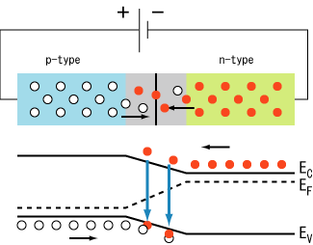
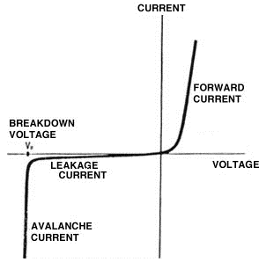

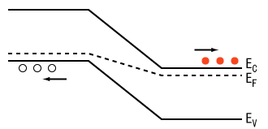
Diode (pn-junction)
thermal diffusion only
with external bias
forward bias: V_{pn}>0
I=I₀(e^{eV/kT}-1)
V_{pn}-|V_{bi}|
-I₀
reverse bias: V_{pn}<0
-(|V_{pn}|+|V_{bi}|)

Slide 16
Planar microstrip silicon
J. Kemmer (1980)
n⁺
(implant)
ca.10¹⁴/cm²/(1um)
d
reverse
bias
Junction
(depletion develops)
300um
typ.
+
p-bulk
-
p-p⁺: ohmic contact
p⁺
(diffusion)
low impedance connection between
Al electrode and p-bulk
Al
(evaporation)
full depletion voltage for 300um
V_{b} | 1 kΩcm | 4 kΩcm
n-bulk | 320V | 80V
p-bulk | 880V | 220V
[um]
Resistivity (of p-bulk)
Carrier mobility (480 vs 1350 cm²/Vs for p vs n-bulk)

Slide 17
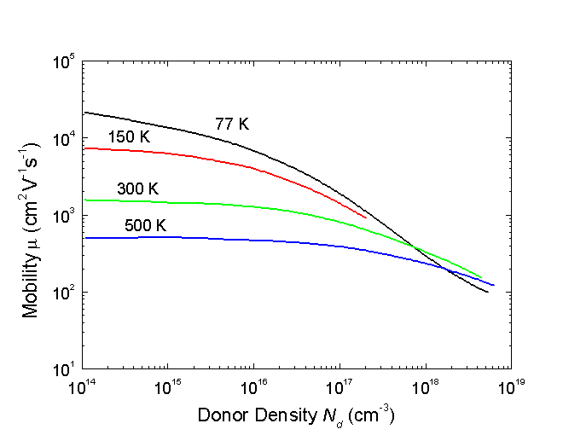
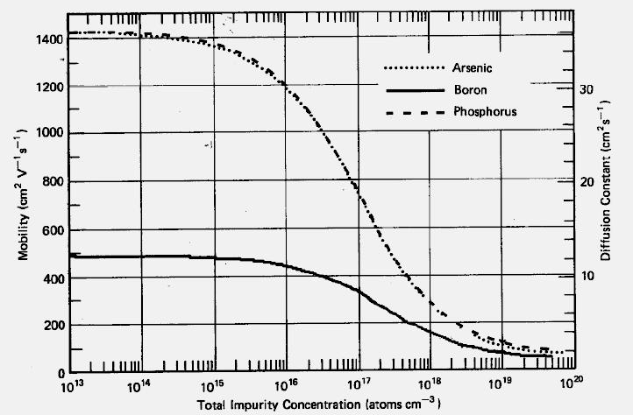
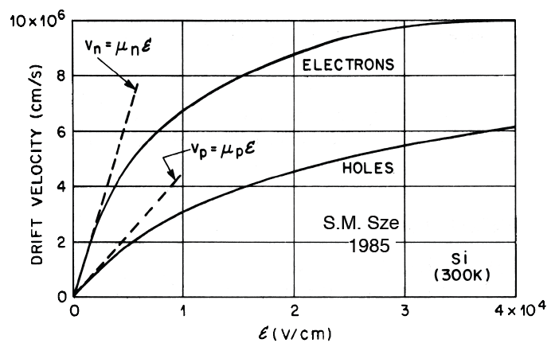

Carrier mobility
depends on carrier density, temperature & E-field
cm²/s/V
electron
hole
For E=200V/300um, 100V/300um
drift velocity
Electrons: t(300um)=4ns, 6ns
Holes: t(300um)=12ns, 20ns
@RT and in high resistive bulk
E-field
Typical gas drift (v=5us/cm): t(2mm)~400ns

Slide 18
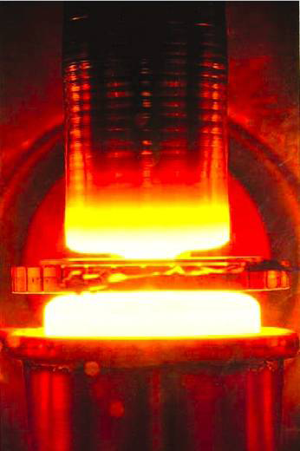
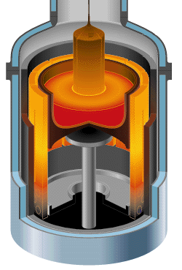
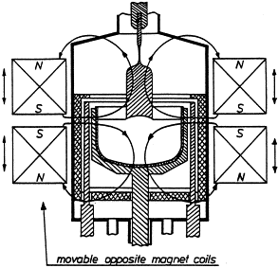
High purity silicon
carriers contribute resistivity
melting & crystallization purifies the silicon: ”segregation”
e.g. 4 kΩcm resistivity
silicon crystal:
standard IC: a few Ωcm
N_{D}~3x10¹²/cm³
cf
N ~5x10²² atoms/cm³
N_{A}~1x10¹²/cm³
Float-zone
~10kΩcm
M-Czochralski
~30cmφ
poly-silicon
crucible (Pt)
magnetic field to dump oscillation in the melt
RF heater
(no contact)
single crystal
new for HEP detector:
high oxygen content helps improve rad-hardness & cheaper
standard high resistivity silicon (15cmφ) used to make HEP detectors

Slide 19
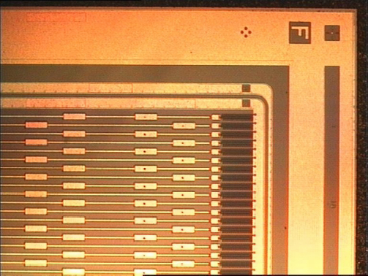
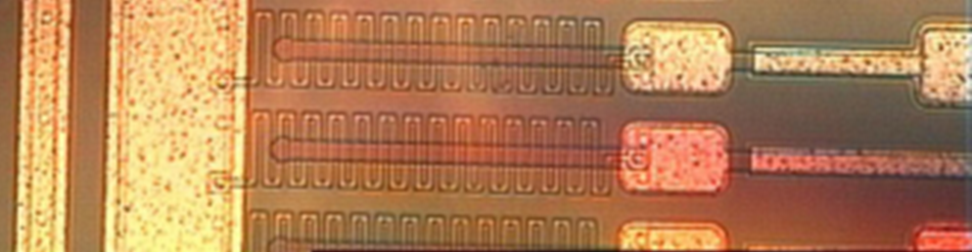
Microstrip
ATLAS SCT p⁺-on-n sensor: HPK
V_{bias}
1mm(~3xthickness)
Edge implant
(shiny part is aluminum)
floating
Guard ring
0V
Bias ring
dummy
r/o
poly-crystalline
silicon
(~1MΩ/mm)
(~0V)
DC contact
80um
AC pad (wire bond)
DC pad (testing)
p⁺ implant (16um=0.2pitch)

Slide 20
Planar microstrip silicon
edge+surface current
backplane & edge are at Vbias
Guard ring
Bias ring
SiO₂ insulator
(coupling cap.)
h
h
h
h
h
V_{guard} settled to minimize E-field
e
e
e
e
e
reverse
bias
d
300um
typ.
+
p-bulk
leakage current
-
p⁺
Al
C_{cp}~20pF/cm
1. e-h pair created /3.6eV
(1.1eV+lattice vibration) => 80eh/1um
2. Carriers drift to electrodes, inducing
charge on “nearby” electrodes
3. signal pulse picked up by amp.
Rbias
~1.5M
C_{int}~0.5pF/cm
w/o depletion:
C_{back}~0.2pF/cm
(#carriers=N_{h}x0.1x0.3x10mm)~10⁹>>(signal)80x300
signal carriers recombine

Slide 21
Further implants
n⁺-on-p
p-stop ca.10¹³/cm²
Fixed positive charges at Si-SiO₂ interface
attracts mobile electrons,
which shorts n⁺ electrodes together
SiO₂
- - - - - -
- - - - - -
- - - - - -
- - - -
P-bulk
p-stop: p⁺ blocking electrode
p-spray ca.2x10¹²/cm²
SiO₂
p-spray: uniform p⁺
(no mask, moderate density)
- - - - - -
- - - - - -
- - - - - -
- - - -
P-bulk
HISTORICALLY
large Si detector systems employed:
p⁺-on-n
… simple
SiO₂
n⁺-on-n in addition
- - - - - -
- - - - - -
- - - - - -
- - - -
… double sided
n⁺-on-n
n-bulk
LHC
n⁺-on-n (single)
n⁺-on-p
rad resistance
p⁺-on-n
p⁺-n-p⁺
- - - - - -
(isolated)

Slide 22
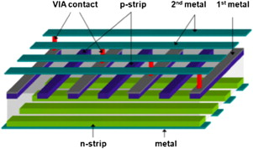
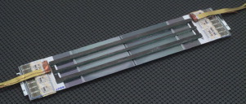
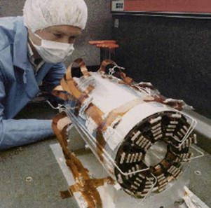
Double sided microstrip
Want to readout from ends of ladder
90º strips routed by 2nd metal*
small stereo readout
r/o
*ultimate strip technology
double-sided expensive process
r/o
CDF SVX2F
r/o chips

Slide 23
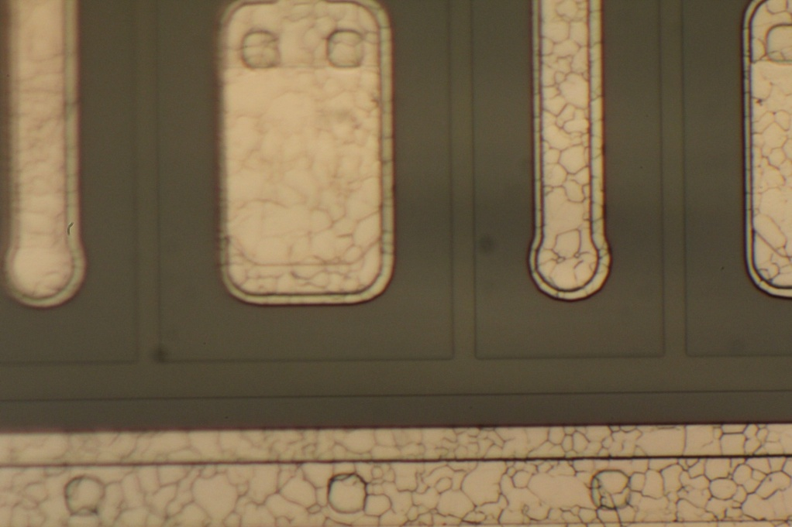
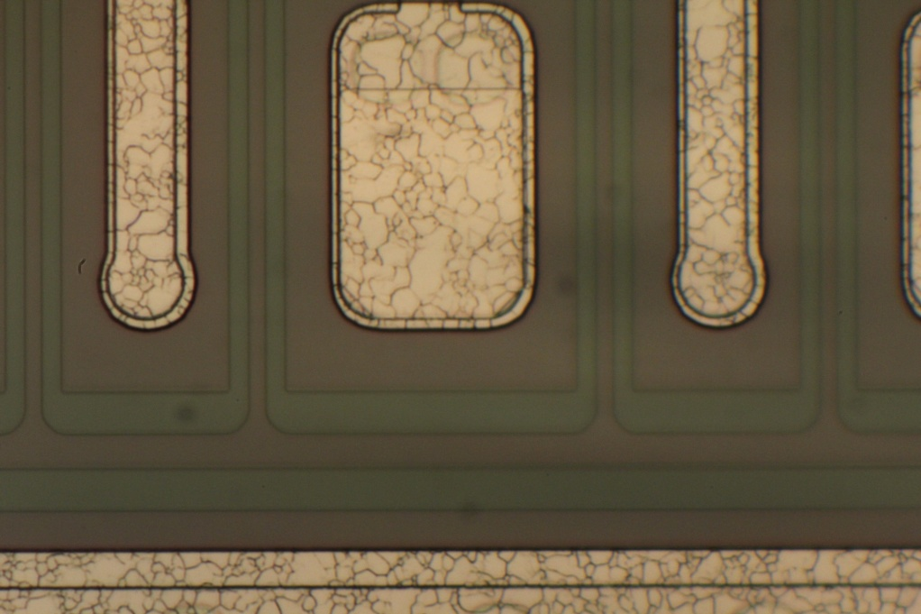
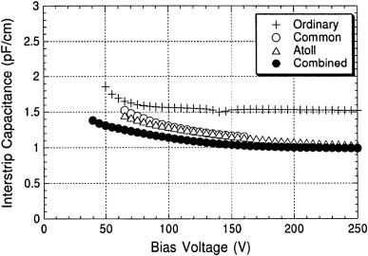
P-stop - some detail
“common” p-stop: p-stop lines connected together over the strip ends
“individual” or “atoll” p-stop: p-stop encloses each implant
Bias ring
Any flaw may affect to all strips
Need more space
Interstrip capacitance is an important parameter for S/N: small for both design

Slide 24
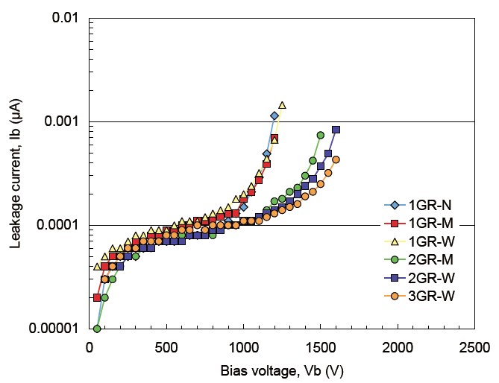
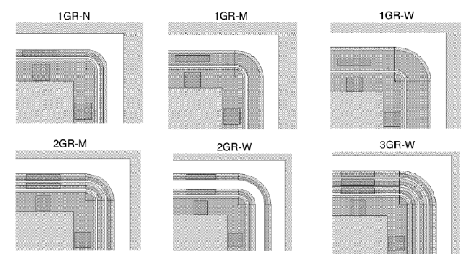
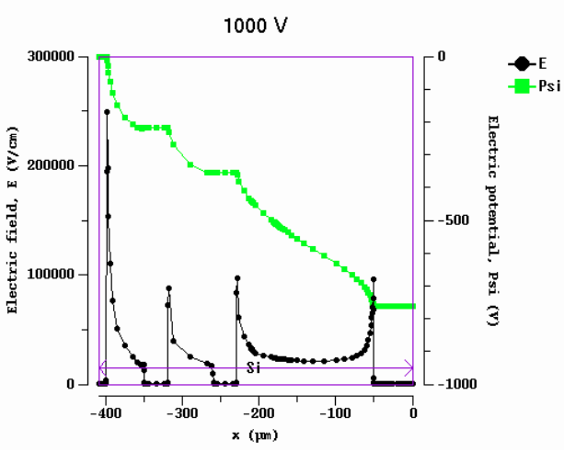
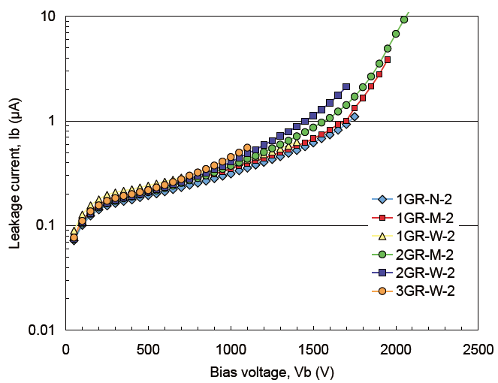

Guard ring
VERTEX2011
Pre-irradiation
0V(BR)
-1kV(back)
Si breakdown E(30V/um)
GRs are floating.
φ settled to minimize E
TCAD simulation on E, φ

Slide 25
IV – leakage current
Bulk current
n+
d
depleted p
undepleted p
p+
responsible for bulk current generation
characteristic Temp dependence
increase with radiation dose
constant beyond full depletion
2. Surface current
slow increase above full dep (non-constant component)
may substantial at low Vb
3. micro-discharge (quick increase at high bias)
carrier accelerated (mfp~30nm@RT) enough to create another e-h pair=> avalanche multiplication
occur at high E (design, scratch,,,)
I₃ decreases with T (more disturbance for avalanche)

Slide 26
Temperature dep. of leakage current
Diffusion current: negligible for a fully depleted devices
Generation current:
- Thermal generation in the depleted region
Thermal runaway:
(approximately)
Reduced using long lifetime (τ₀) material (= pure and defect free)
Generation current is doubled for ΔT=7-8K
Opposite to metals where leakage decreases with temperature
Current
increase
Proper heat sink required in some applications
Temperature
increase
Heat
device

Slide 27
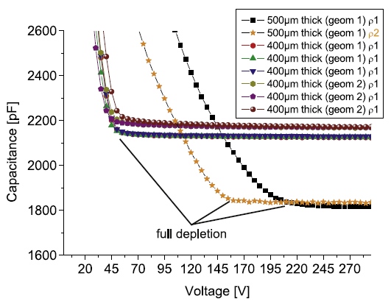
CV – bulk capacitance
parallel plate condenser approx
n+
undepleted p
(V_{b}<V_{FD})
p+
A: effective plate area
(V_{b}>V_{FD})
Si permittivity
nF/mm
1/C²
Strip structure
V_{FD}
V_{b}
Notes:
p

Slide 28
C_{int} – interstrip capacitance
LCR meter measures Z
C_{cp}~20pF/cm
inductive
Rbias
~1.5M
input
resistive
C_{int}~0.5pF/cm
C_{back}~0.2pF/cm
capacitive
Z=R-jC/ω
values are typical
Largest contribution to “Detector capacitance”
Keep C_{int} smaller (restriction from geometry)
To measure C, substantial C contribution in the circuit is preferred:
Q_{noise} ~ C_{DET} x V_{noise}
more signal deficit if C_{int} is large (AC device)
ω
R_{bias}
good with small ω
f~1 kHz
good with large ω
f~1 MHz
Interstrip region depletion
C_{bulk}
C_{int}
R_{bias}
ω
C_{int}
V_{FD}
V_{b}
Notes:
p

Slide 29
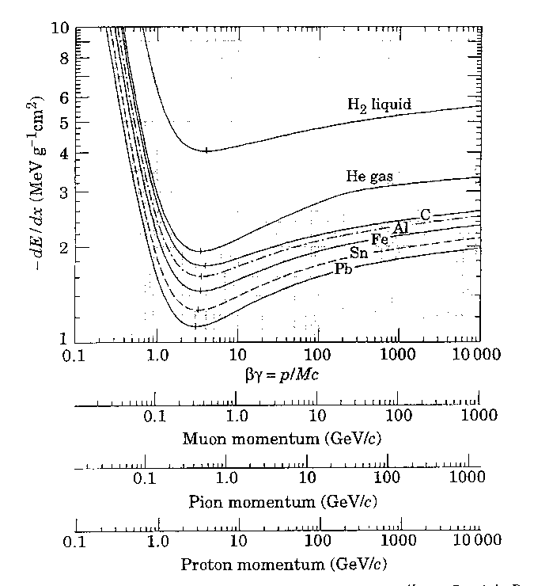

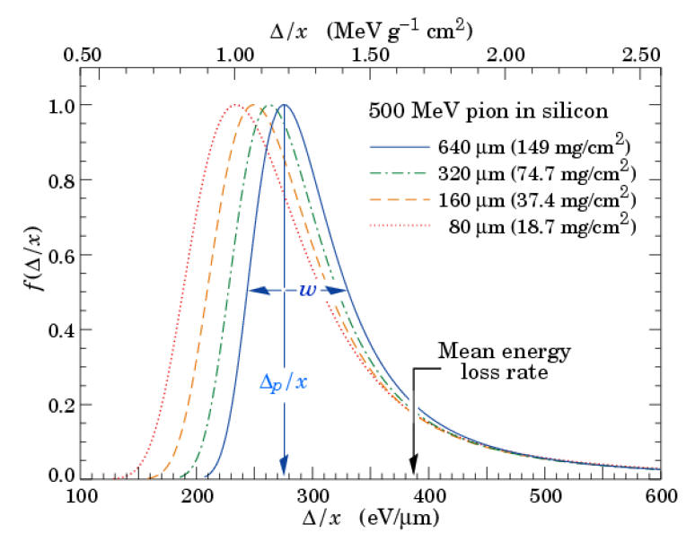
Signal size
excitations
frequency
distant collision
close collision
1.7MeV/(g/cm²)
=>390eV/um in Si
δ-ray
mean energy loss
mean
energetic electrons
E_{trans}/interaction
thick material:
good sampling about the mean
“conceptual” explanation of Landau tail
good sampling in lower energy
medium thick
fluctuation in
higher energy
thinner
good sampling shifts lower
54eh/um
Edep/thickness
82eh/um

Slide 30
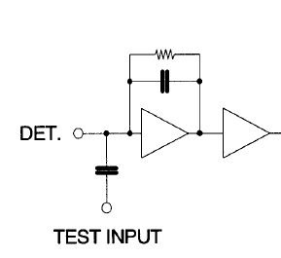
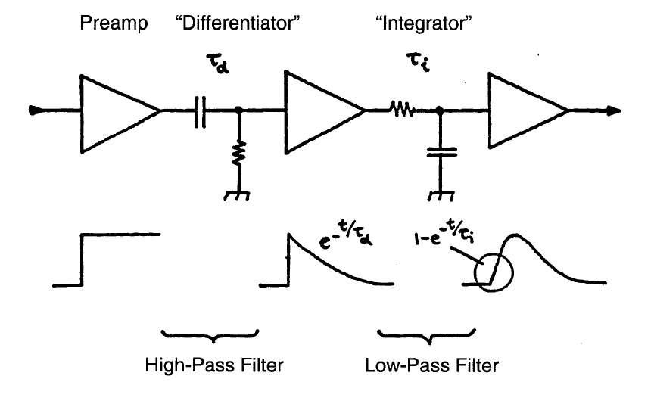
Signal processing – preamp+shaper
FrontEnd amplifier stage:
preamp + shaper amp
CR-RC shaping (example)
R_{F},C_{F}
gain&BW
Purpose of shaper:
set a window of frequency range appropriate for signal (S/N improved)
constant time profile
Pulse height sampling for further processing
(discrimination, ADC,,,)
Fast baseline restoration
Pulse peaking time
choose time constant:
shorter – better two pulse separation
longer – better noise performance (next pg)

Slide 31

Noise components
Noise contributions from:
Leakage current (I)
Detector capacitance (C_{D})
Parallel resistance (Rp)
Series resistance (Rs)
Detector
peaking time
Signal peaking time tp is an important factor
ENC: equivalent noise charge in number of electrons at amplifier input
@T=300K
cf: signal charge~24000(300um)
small t_{p}, large R_{P} (bias resistor)
small R_{S} (aluminum line resistance), large t_{p}
important for fast peaking
small I, t_{p}
significant for irradiated sensors
a,b: amplifier design – ENC (C_{D}) largest typically
LEP: 500+15C_{D}
LHC: 530+50C_{D}
be small such that S/N>ca.10

Slide 32

Signal processing on detector
ATLAS
Binary readout (ON/OFF)
3 BC(beam crossing) info
25ns BC
hit
=5.28us
noise
Stores hit pattern & sends the patterns at the corresponding trigger BCid

Slide 33


Need more – of course
Communication + power cables: low-mass cable on detector
Patched outside the detector volume to Communication : optical fiber cables
Power: bulky cables

Slide 34


Radiation damage - mechanism
Hole trap
Holes created in insulator are less mobile, insulators are charged
(Surface damage)
Degrades strip isolation, induce surface current(?)
Dose [Gy]
Point defects
Cluster defects
disordered region
MeV γ,e, 10MeV p
MeV n
High energy particles: Point Defects+Cluster Defects
(Bulk damage)
Carrier trap, leakage current, change Neff (n->p)
Fluence [1-MeV neutron-equivalent/cm²]

Slide 35

NIEL – non-ionizing energy loss
Energy loss due to other than ionization
Difference due to
different energy
different particle type
D(E) scaled to 1-MeV equivalent damage:
1-MeV n_{eq}/cm²
1st level comparison
Fails in some cases
G.Lindstroem (2003)

Slide 36
Impact of Defects on Detector properties
Inter-center charge transfer model (inside clusters only)
Shockley-Read-Hall statistics (standard theory)
charged defects ⇒ N_{eff} , V_{dep} e.g. donors in upper and acceptors in lower half of band gap
Trapping (e and h) ⇒ CCE shallow defects do not contribute at room temperature due to fast detrapping
generation ⇒ leakage current Levels close to midgap most effective
enhanced generation ⇒ leakage current ⇒ space charge
Impact on detector properties can be calculated if all defect parameters are known: σ_{n,p} : cross sections ΔE : ionization energy N_{t} : concentration

Slide 37


Defects identification
Deep level transient spectroscopy
I. Pintille et al (2009)
evaluate E_{i} from diode capacitance change with T
Some identified defects
Most defects are acceptor like;
n-type sensor type-inverts after receiving certain radiation
R.Wunstorf (1992)

Slide 38


Temperature effect - annealing
beneficial
reverse
ATLAS SCT
G.Lindstroem (2003)
P.Dervan et al
Interstitials recombine with Vacancies
In longer term, vacancies combine with themselves or with impurity atoms to become stable defects
- time constant depends on temperature: ~ 500 years (-10°C) ~ 500 days ( 20°C) ~ 21 hours ( 60°C) - Consequence: Detectors must be cooled even when the experiment is not running!
V₂, V₃, VO, VC,,,

Slide 39
Radiation damage - Leakage current
Damage parameter α (slope in figure)
Leakage current (20degC, @V_{FD}) per unit volume and particle fluence
α is constant over several orders of fluence and independent of impurity concentration in Si  can be used for fluence measurement
80 min 60°C
Initial annealing completed, allowing comparison of irradiations in different conditions (irradiation rate)

Slide 40


Fluence at HL-LHC
I.Dawson: Vertex2012
3x10¹⁴
5x10¹⁴
1x10¹⁵

Slide 41
Rad-hard: p-bulk sensor
Fluence > a few 10¹⁴ /cm²
p⁺-on-n
n-bulk
n⁺-on-p
depletion
P-bulk
Type inversion
p-bulk
stays p (depletion develops always from strips)
operational at partial depletion if V_{FD} exceeds the maximum allowed (reduced signal amount is tolerable by choosing the strip length shorter, thus smaller C_{D} for noise)
radiation damage is less since faster electron carriers are collected (smaller trapping)
Need full depletion for strip isolation

Slide 42


Charge collection: p-bulk sensor for HL-LHC
short strips
(2.4cm long)
S/N=10
un-irrad
long strips
(9.6 cm long)
Collectable charge decreases with fluence
Strip length is short (2.4cm) to cope with high particle density: this reduces C_{D} hence noise
V_{b}~500V is enough to achieve S/N>10
S/N=10

Slide 43




Silicon Variations

Slide 44

Silicon drift sensor
built-in resistors
LHC-ALICE silicon drift sensor
-V
Collect electrons towards the anode
(measure drift time to determine Y)
V_{drift}~8mm/us
X
Spatial Resolution (ALICE testbeam)
20-40um in X (294um pitch)
30-50um in Y
depending on drift distance (diffusion)
-Y
+Y

Slide 45


3D silicon sensor
Charge loss after irradiation is primary due to carrier trap:
Shorten the carrier collection distance
3D
PLANAR
\
50um
n⁺
n⁺
300um
n⁺
P⁺
P⁺
Single-column (low E region)
Double-sided double-column

Slide 46


PIXEL sensor
at LHC experiments
ATLAS: 50x400 um pixels (80M)
CMS: 100x150 um pixels (66M)
3 barrel layers+3/2 discs/EC
Powerful in track pattern recognition
(no ghost hits)
Pixel and readout interconnected by bumps (In or PbSn)
Notes:
Lead-tin

Slide 47




Monolithic device - SOI
Silicon-on-insulator
On-pixel circuit
INTPIX4
512x832 pixels of (17um)²

Slide 48


Wire-bonding
Use ultra-sonic power to alloy the wire (20um diameter aluminum ) with target plate (aluminum)
wire be crushed to ca .twice the original thickness
no “viscus” (creation depends a lot on the surface)
pinches the wire controlling the tension
wedge to feed ultra-sonic power

Slide 49

Handling cautions
Sensor surface is coated with thin layer of SiO₂ or equivalent “passivation” (wire-bonding pads are not passivated): no super-clean required, though dusts may induce troubles
Ions trapped in insulator may degrade the insulator performance (vs HV). Na⁺ is typical ingredient of human : Do not touch by hand
MOS devices dislike electrostatic discharge: Ground yourself before handling
Large current may create permanent current path: Limit the current (1mA is too high)
Large current …: Cool high current sensors, required for irradiated sensors
Notes:
sodium

