Slide 1
Search for neutrino radiative decay and the status of the far-infrared photon detector development
1st CiRfSE Workshop
Mar. 12-13, 2015 / University of Tsukuba, Japan
Yuji Takeuchi (Univ. of Tsukuba)
for Neutrino Decay Collaboration
S.H.Kim , K. Takemasa, K.Kiuchi , K.Nagata , K.Kasahara , T.Okudaira, T.Ichimura, M.Kanamaru, K.Moriuchi, R.Senzaki(Univ. of Tsukuba),
H.Ikeda, S.Matsuura, T.Wada(JAXA/ISAS),
H.Ishino, A.Kibayashi (Okayama Univ), S.Mima (RIKEN), Y.Kato (Kindai Univ.),
T.Yoshida, S.Komura, K.Orikasa, R.Hirose(Univ. of Fukui), Y.Arai, M.Hazumi (KEK),
S. Shiki, M. Ukibe, G. Fujii, T. Adachi, M. Ohkubo (AIST),
E.Ramberg, J.H.Yoo, M.Kozlovsky, P.Rubinov, D.Sergatskov (Fermilab),
S.B.Kim(Seoul National Univ.)

Slide 2
Contents
Introduction to neutrino decay search
  Proposed rocket experiment
  Prospect for the neutrino decay search
Candidates for far-infrared single photon detector/spectrometer
  Nb/Al-STJ with diffraction grating
  Hf-STJ
Summary

Slide 3


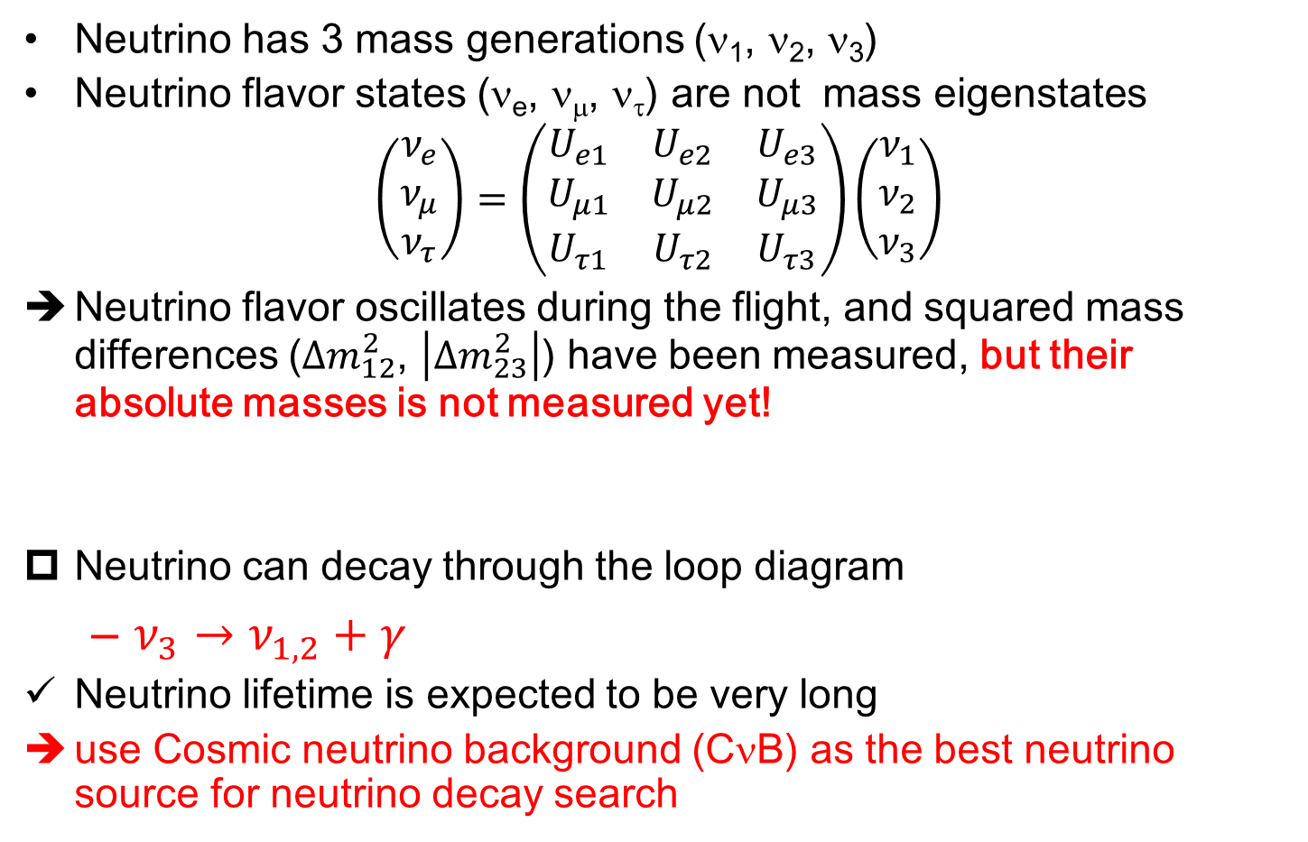



Neutrino
Neutrino has 3 mass generations (ν₁, ν₂, ν₃)
Neutrino flavor states (ν_{e}, ν_{μ}, ν_{τ}) are not mass eigenstates
$$\left(\begin{matrix}ν_{e} \\ ν_{μ} \\ ν_{τ}\end{matrix}\right)=\left(\begin{matrix}U_{e1} & U_{e2} & U_{e3} \\ U_{μ1} & U_{μ2} & U_{μ3} \\ U_{τ1} & U_{τ2} & U_{τ3}\end{matrix}\right)\left(\begin{matrix}ν_{1} \\ ν_{2} \\ ν_{3}\end{matrix}\right)$$
Neutrino flavor oscillates during the flight, and squared mass differences ($Δm_{12}^{2}$, $\left|Δm_{23}^{2}\right|$) have been measured, but their absolute masses is not measured yet!
Neutrino can decay through the loop diagram
  $ν_{3}→ν_{1,2}+γ$
Neutrino lifetime is expected to be very long
use Cosmic neutrino background (CνB) as the best neutrino source for neutrino decay search
$$ν_{1,2}$$
$$γ$$
$$e,μ,τ$$
$$W$$
$$ν_{3}$$

Slide 4
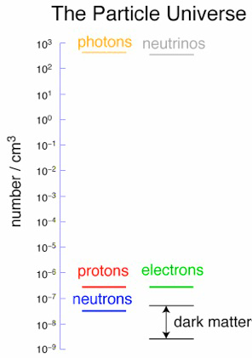
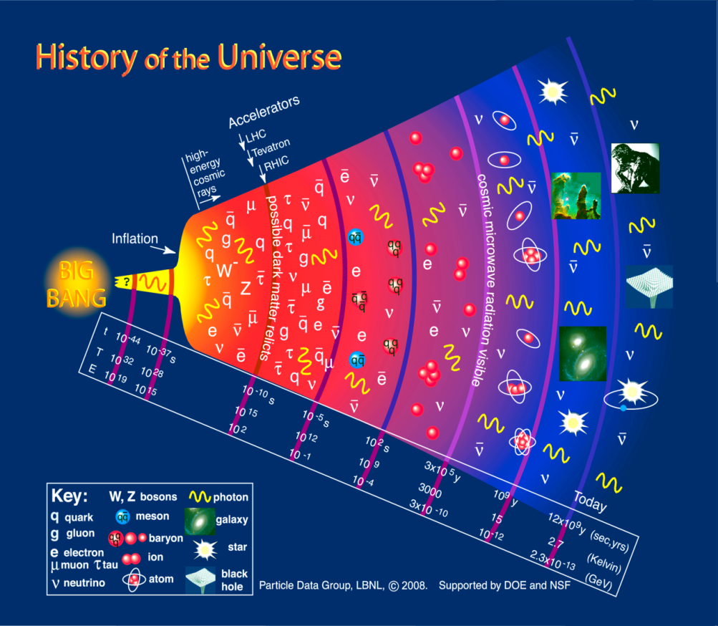
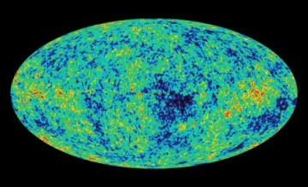
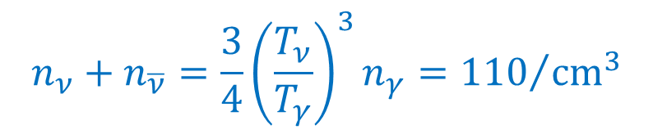
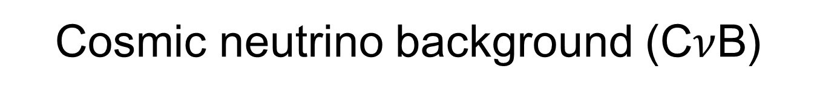

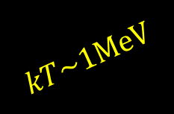



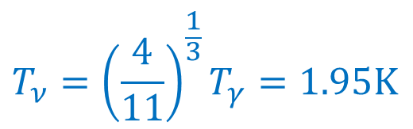
Cosmic neutrino background (C$ν$B)
$$kT\sim 1MeV$$
$${10}^{2}$$
CMB
$$n_{γ}=411/{cm}^{3}$$
$$T_{γ}=2.73 K$$
The universe is filled with neutrinos.
But they are not detected yet!
Density (cm⁻³)
$${10}^{−7}$$
CνB (~1s after big bang)
$$T_{ν}={\left(\frac{4}{11}\right)}^{\frac{1}{3}}T_{γ}=1.95K$$
$$n_{ν}+n_{\overline{ν}}={\frac{3}{4}\left(\frac{T_{ν}}{T_{γ}}\right)}^{3}n_{γ}={110}/{{cm}^{3}}$$
$$\left\langle p_{ν}\right\rangle =0.5meV/c$$

Slide 5




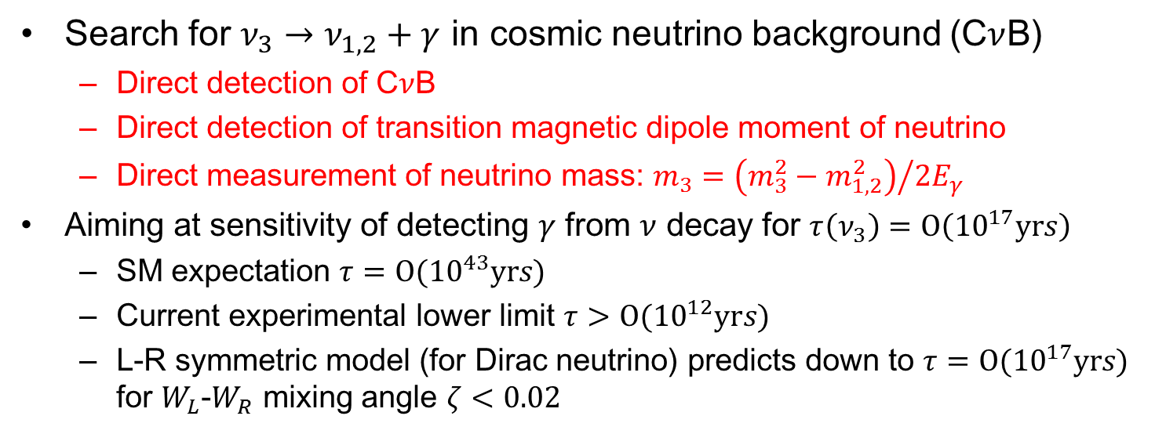













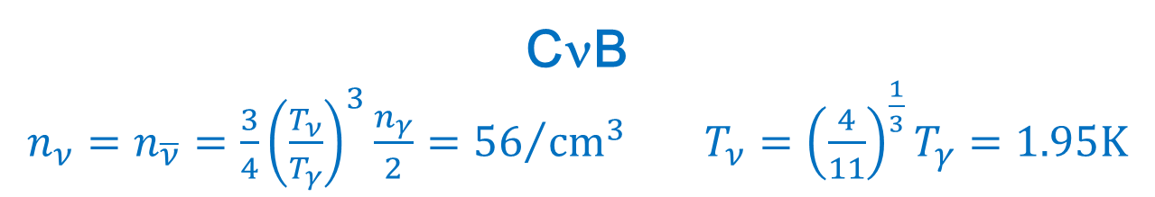


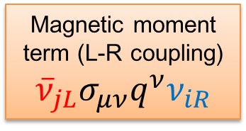

Motivation of ν-decay search in CνB
Search for $ν_{3}→ν_{1,2}+γ$ in cosmic neutrino background (C$ν$B)
  Direct detection of C$ν$B
  Direct detection of transition magnetic dipole moment of neutrino
  Direct measurement of neutrino mass: $m_{3}={\left(m_{3}^{2}−m_{1,2}^{2}\right)}/{2E_{γ}}$
Aiming at sensitivity of detecting $γ$ from $ν$ decay for $τ\left(ν_{3}\right)=Ο\left({10}^{17}yrs\right)$
  SM expectation ${τ=Ο(10}^{43}yrs)$
  Current experimental lower limit ${τ>Ο(10}^{12}yrs)$
  L-R symmetric model (for Dirac neutrino) predicts down to ${τ=Ο(10}^{17}yrs)$ for $W_{L}$-$W_{R}$ mixing angle $ζ<0.02$
Magnetic moment term (L-R coupling)
$${\overline{ν}}_{jL}σ_{μν}q^{ν}ν_{iR}$$
SM: SU(2)_{L}ｘ U(1)_{Y}
LRS: SU(2)_{L}ｘSU(2)_{R}ｘU(1)_{B-L}
$$ν_{1,2L}$$
$$ν_{1,2L}$$
PRL 38,(1977)1252, PRD 17(1978)1395
$$γ$$
$$\left(\begin{aligned}W_{1} \\ W_{2}\end{aligned}\right)=\left(\begin{matrix}cosζ & −sinζ \\ sinζ & cosζ\end{matrix}\right)\left(\begin{aligned}W_{L} \\ W_{R}\end{aligned}\right)$$
$$e_{L},μ_{L},τ_{L}$$
$$γ$$
$$τ_{L}$$
$$ν_{3L}$$
$$m_{τ}$$
10²⁶ enhancement to SM
$$ν_{jL}$$
$$W_{L}$$
$$ν_{3R}$$
$$W_{1}$$
$$τ_{R}$$
$$γ$$
$$m_{ν_{3}}$$
$$ν_{3R}$$
$$≃W_{L}−ζW_{R}$$
$$ν_{iR}$$
$$Γ\sim {\left({10}^{43} yr\right)}^{−1}$$
$$Γ\sim {\left({10}^{17} yr\right)}^{−1}$$
Suppressed by $m_{ν}$ and GIM
Only suppressed by L-R mixing ($ζ$)

Slide 6
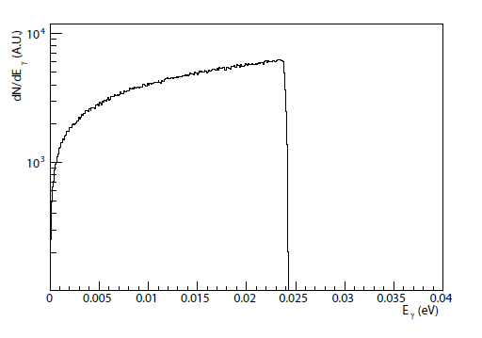

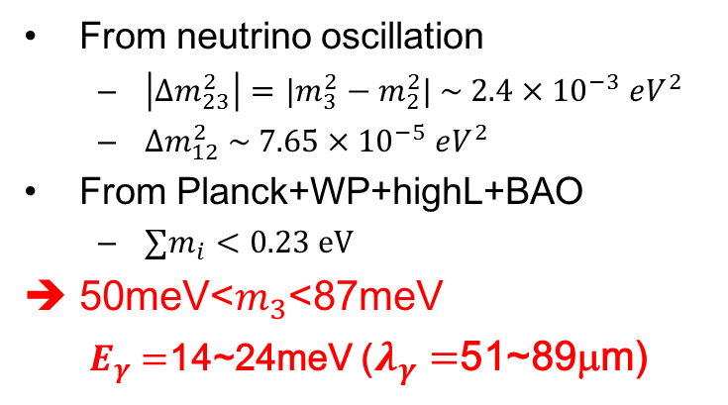





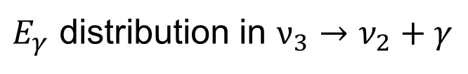
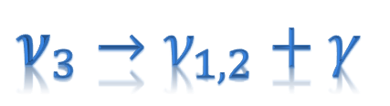



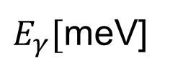
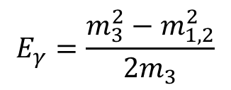
Photon Energy in Neutrino Decay
$$ν_{3}→ν_{1,2}+γ$$
From neutrino oscillation
  $\left|Δm_{23}^{2}\right|={|m}_{3}^{2}−m_{2}^{2}| \sim 2.4×{10}^{−3} eV^{2}$
  $Δm_{12}^{2} \sim 7.65×{10}^{−5} eV^{2}$
From Planck+WP+highL+BAO
  $∑m_{i}<0.23 eV$
50meV<$m_{3}$<87meV
  $E_{γ}=$14~24meV ($λ_{γ}=$51~89μm)
$$γ$$
$$E_{γ}$$
$$ν_{3}$$
$$E_{γ}=\frac{m_{3}^{2}−m_{1,2}^{2}}{2m_{3}}$$
$$ν_{2}$$
Two body decay
$E_{γ}$ distribution in $ν_{3}→ν_{2}+γ$
m₃=50meV
$$m_{3}=50 meV$$
dN/dE(a.u.)
E_{γ} =24.8meV
E_{γ} =24meV
Sharp Edge with 1.9K smearing
Red Shift effect
($50μm$)
($52μm$)
m₂=8.7meV
E_{γ} =4.4meV
$E_{γ}[$meV]
m₁=1meV
($282μm$)
$$25meV(50μm)$$

Slide 7
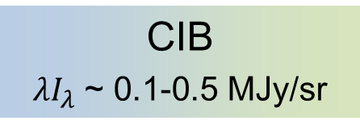
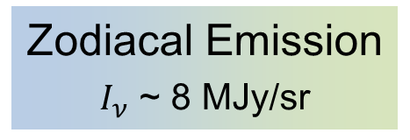


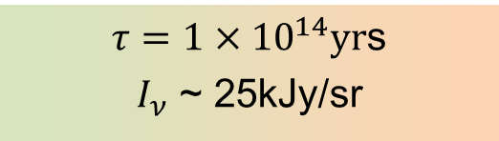
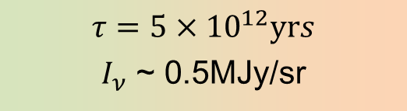
Backgrounds to C$ν$B decay
at λ＝50μm
AKARI
CMB
ZE
COBE
Zodiacal Emission
$I_{ν}$ ~ 8 MJy/sr
ZL
CIB
${λI}_{λ}$ ~ 0.1-0.5 MJy/sr
Surface brightness I_{ν} [MJy/sr]
ISD
CνB decay
CνB decay
DGL
Expected $E_{γ}$spectrum
$$m_{3}=50meV$$
SL
$τ={5×10}^{12}yrs$
$I_{ν}$ ~ 0.5MJy/sr
wavelength [μm]
E_{γ} [meV]
$τ={1×10}^{14}yr$s
$I_{ν}$ ~ 25kJy/sr
λ＝50 μm
E_{γ}=25 meV

Slide 8
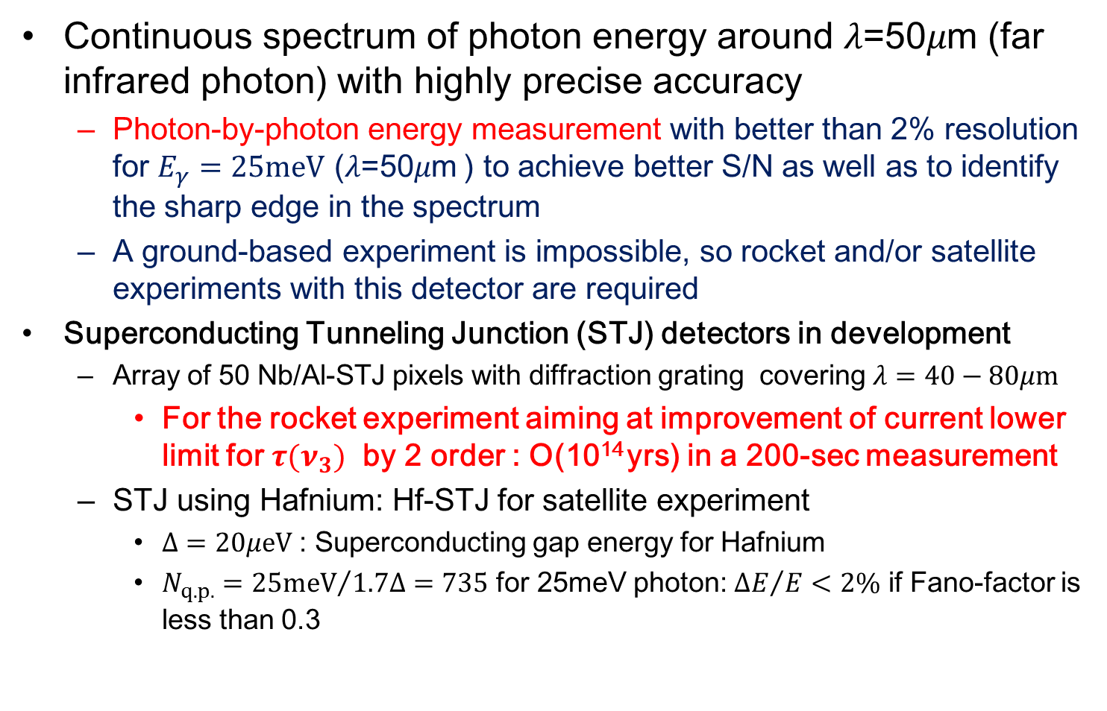
Detector requirements
Continuous spectrum of photon energy around 𝜆=50𝜇m (far infrared photon) with highly precise accuracy
  Photon-by-photon energy measurement with better than 2% resolution for $E_{γ}=25meV$ (𝜆=50𝜇m ) to achieve better S/N as well as to identify the sharp edge in the spectrum
  A ground-based experiment is impossible, so rocket and/or satellite experiments with this detector are required
Superconducting Tunneling Junction (STJ) detectors in development
  Array of 50 Nb/Al-STJ pixels with diffraction grating covering $λ=40−80μm$
    For the rocket experiment aiming at improvement of current lower limit for $τ(ν_{3})$ by 2 order : O(10¹⁴ yrs) in a 200-sec measurement
  STJ using Hafnium: Hf-STJ for satellite experiment
    $Δ=20μeV$ : Superconducting gap energy for Hafnium
    $N_{q.p.}={25meV}/{1.7Δ}=735$ for 25meV photon: ${ΔE}/E<2\%$ if Fano-factor is less than 0.3

Slide 9
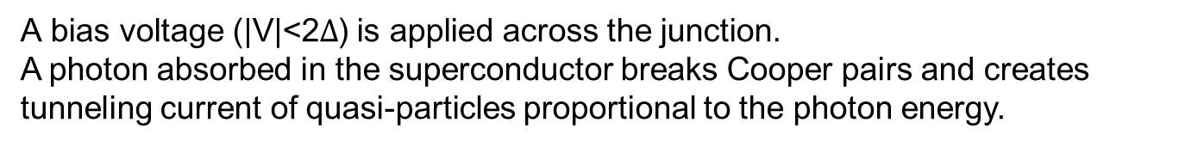

STJ(Superconducting Tunnel Junction）Detector
Superconductor / Insulator /Superconductor Josephson junction device
$$2Δ$$
Δ: Superconducting gap energy
A bias voltage (|V|<2$Δ$) is applied across the junction.
A photon absorbed in the superconductor breaks Cooper pairs and creates tunneling current of quasi-particles proportional to the photon energy.

Slide 10
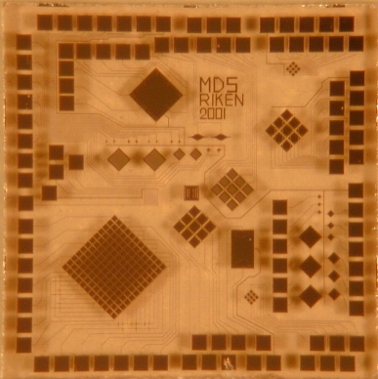
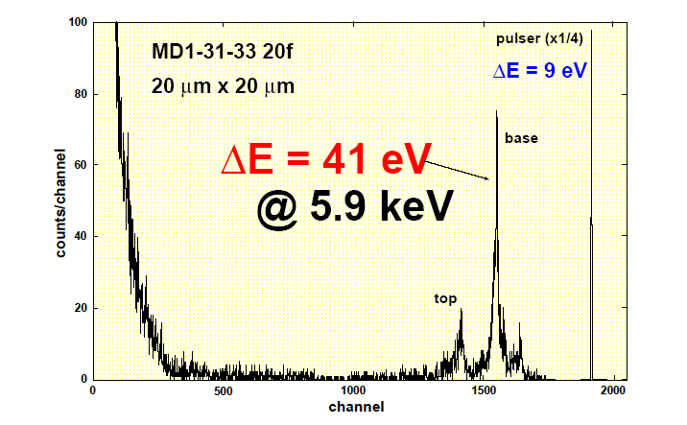
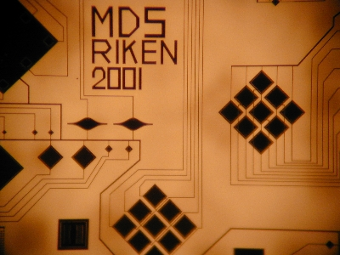
STJ examples
5mm
5.9KeV X-ray
100μm x 100μm
5mm
H. Sato (RIKEN)
STJs are already in practical use as a single photon spectrometer for a photon ranging from near-infrared to X-ray, and show excellent performances comparing to conventional semiconductor detectors
But no example for far-infrared photon so far

Slide 11
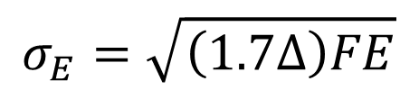
STJ energy resolution
Statistical fluctuation in number of quasi-particles determines energy resolution
Smaller superconducting gap energy Δ yields better energy resolution
Δ: Superconducting gap energy
F: fano factor
E: Photon energy
$$σ_{E}=\sqrt{\left(1.7Δ\right)FE}$$
 | Si | Nb | Al | Hf
Tc[K] |  | 9.23 | 1.20 | 0.165
Δ[meV] | 1100 | 1.550 | 0.172 | 0.020
Tc :SC critical temperature
Need ~1/10Tc for practical
operation
Nb
Well-established as Nb/Al-STJ
(back-tunneling gain from Al-layers)
N_{q.p.}=25meV/1.7Δ=9.5
Poor energy resolution, but photon counting is possible in principle
Hf
Hf-STJ is not established as a practical photon detector
N_{q.p.}=25meV/1.7Δ=735
  2% energy resolution is achievable if Fano factor <0.3
In both cases, developments are challenging
Notes:
11

Slide 12
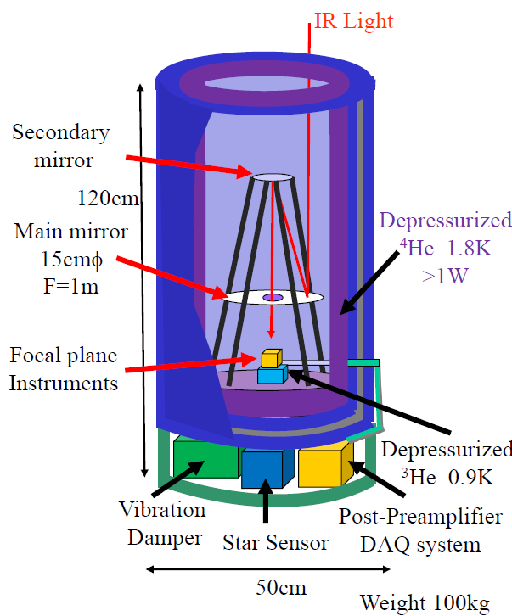
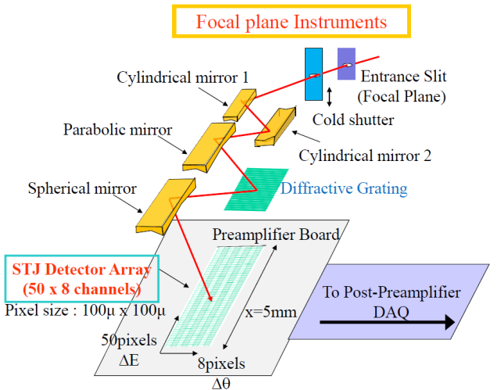
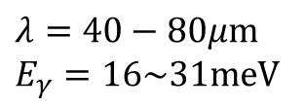
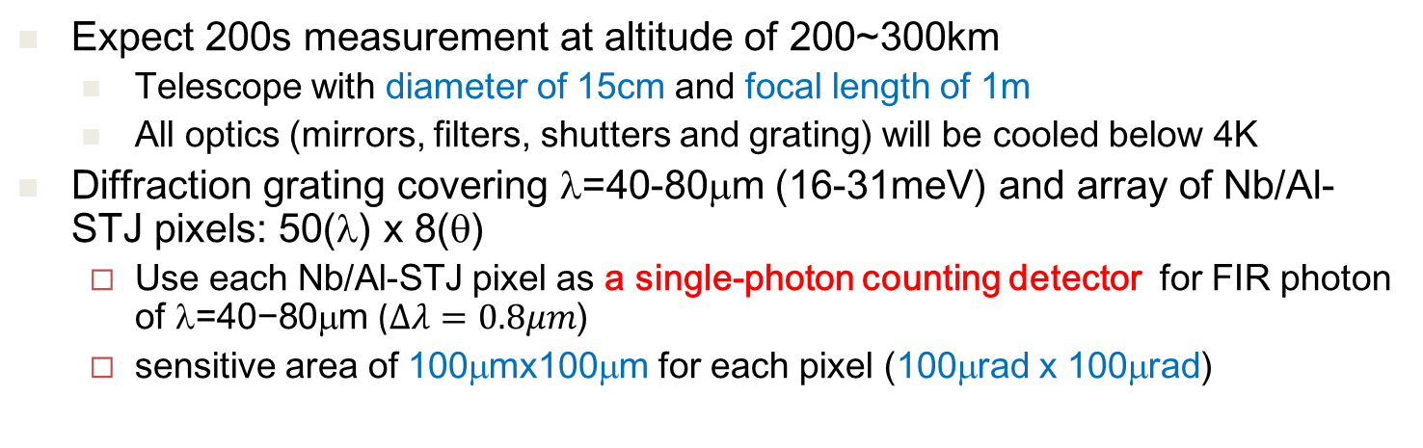


Proposal of a rocket experiment
  Expect 200s measurement at altitude of 200~300km
    Telescope with diameter of 15cm and focal length of 1m
    All optics (mirrors, filters, shutters and grating) will be cooled below 4K
  Diffraction grating covering λ=40-80μm (16-31meV) and array of Nb/Al-STJ pixels: 50(λ) x 8(θ)
  Use each Nb/Al-STJ pixel as a single-photon counting detector for FIR photon of $\text{}\text{=40−80}\text{μ}\text{m}$ ($Δλ=0.8μm$)
  sensitive area of 100μmx100μm for each pixel (100μrad x 100μrad)
Nb/Al-STJ array
$λ=40−80μm$ $E_{γ}=16\sim 31meV$
$$Δθ$$
$$Δλ$$

Slide 13
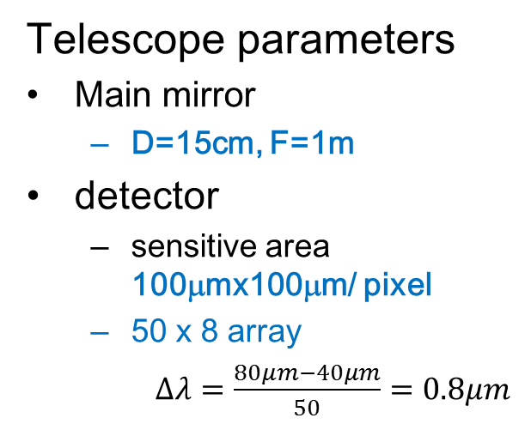

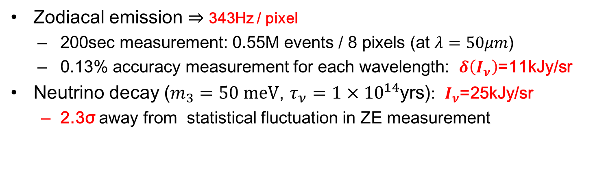
Expected accuracy in the spectrum measurement
Telescope parameters
Main mirror
  D=15cm, F=1m
detector
  sensitive area 100μmx100μm/ pixel
  50 x 8 array
  $Δλ=\frac{80μm−40μm}{50}=0.8μm$
Zodiacal Emission
CMB
Zodiacal Light
Surface brightness I_{ν} [MJy/sr]
ISD
CνB decay
DGL
SL
Integrated flux from galaxy counts
wavelength [μm]
$τ={1×10}^{14}yr$
  Zodiacal emission $⇒$ 343Hz / pixel
  200sec measurement: 0.55M events / 8 pixels (at $λ=50μm$)
  0.13% accuracy measurement for each wavelength: $δ\left(I_{ν}\right)$=11kJy/sr
Neutrino decay ($m_{3}=50 meV$, $τ_{ν}=1×{10}^{14}$yrs): $I_{ν}$=25kJy/sr
  2.3σ away from statistical fluctuation in ZE measurement
ν decay with $τ_{ν}=10^{14}$ yrs is possible to detect, or set lower limit!

Slide 14
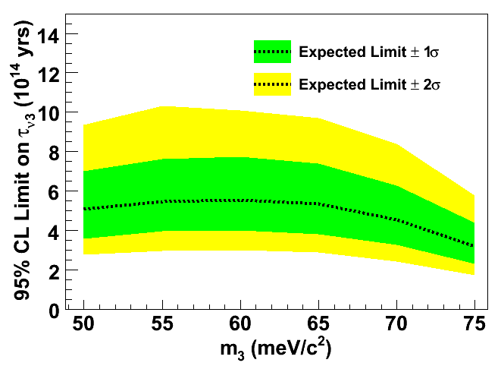
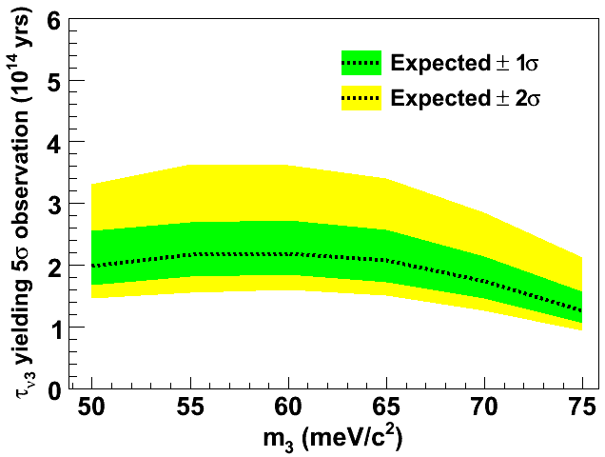
Sensitivity to neutrino decay
Parameters in the rocket experiment simulation
telescope dia.: 15cm
50 (λ: 40μm – 80 μm) × 8 array
Viewing angle per single pixel: 100μrad × 100μrad
Measurement time: 200 sec.
Photon detection efficiency: 100%
Can set lower limit on ν₃ lifetime at 4-6 × 10¹⁴ yrs if no neutrino decay observed
If ν₃ lifetime were 2 × 10¹⁴ yrs, can observe the signal at 5σ significance level

Slide 15
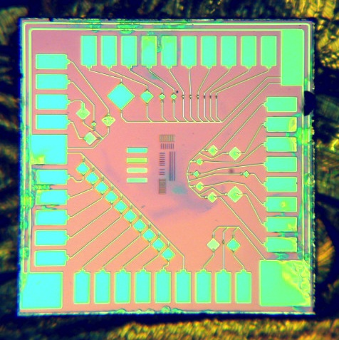
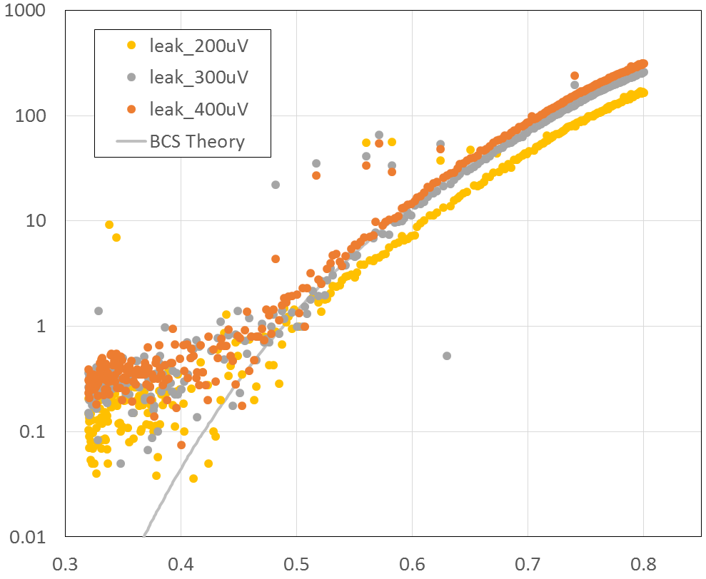

Status of Nb/Al-STJ photon detector development
Requirements for Nb/Al-STJ
Single photon detection for E_{γ}=25meV (λ=50μm)
  Detection efficiency: ~1
Dark count rate < 30Hz ➔ STJ leak current < 0.1nA
Sensitive area: 100μm × 100μm
2.9mm
Leak current [nA]
0.1nA
50μm × 50μm Nb/Al-STJ fabricated at CRAVITY in AIST
I_{leak}<1nA achieved at AIST
We will try STJs with a smaller junction size
Temperature [K]

Slide 16
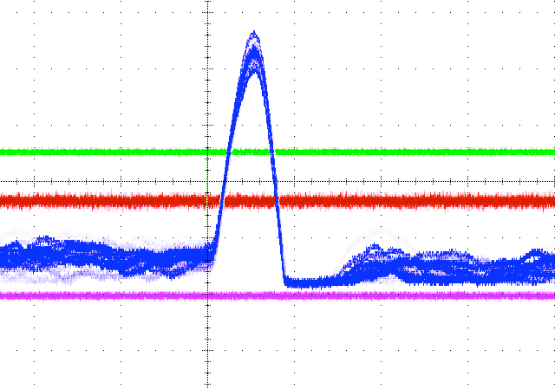
100x100μm² Nb/Al-STJ response to 465nm multi-photons
100x100μm² Nb/Al-STJ fabricated at CRAVITY
Laser pulse trigger
2V/DIV
10M
40μs/DIV
465nm laser through optical fiber
Charge sensitive
pre-amp.
shaper amp.
STJ
Dispersion of pulse height is consistent with 10~40-photon detection in STJ
T~350m
(³He sorption)
We observed a response of Nb/Al-STJs to NIR-VIS photons at nearly single photon level
Response time of STJ: O(1μs)
Due to the readout noise, we have not achieved FIR single photon detection
Need ultra-low noise readout system for STJ signal

Slide 17
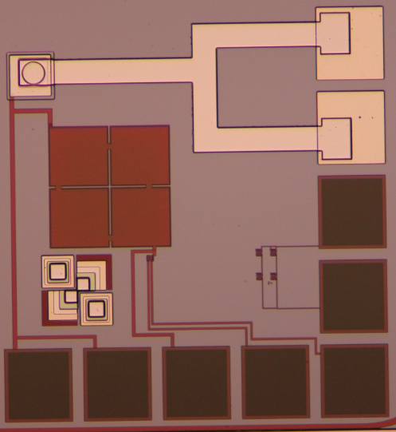
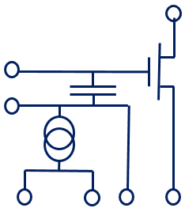
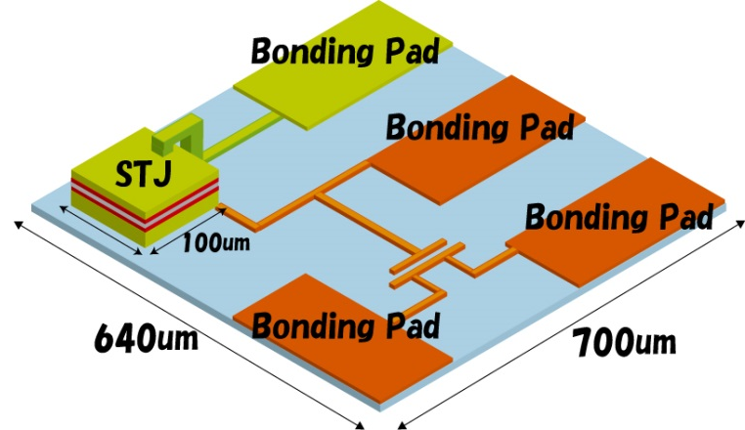
Development of SOI-STJ
SOI: Silicon-on-insulator
  CMOS in FD-SOI is reported to work at 4.2K by T. Wada (JAXA), et al.
A development of SOI-STJ for our application
  STJ layer is fabricated directly on SOI pre-amplifier and cooled down together with STJ
Started test with Nb/Al-STJ on SOI with p-MOS and n-MOS FET
Phys. 167, 602 (2012)
640 um
STJ
Nb
STJ
metal pad
via
SOI
STJ lower layer has electrical contact with SOI circuit
capacitor
SOI-STJ2 circuit
D
700 um
G
C
FET
S

Slide 18
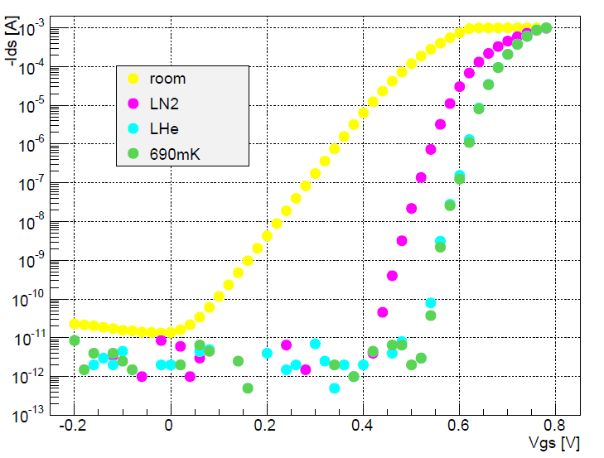
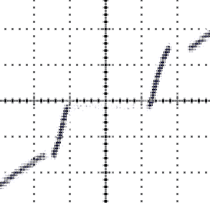
FD-SOI on which STJ is fabricated
Ids [A]
1mA/DIV
2mV/DIV
B~150Gauss
V_{gs}[V]
I-V curve of a STJ fabricated at KEK on a FD-SOI wafer
nMOS-FET in FD-SOI wafer on which a STJ is fabricated at KEK
Both nMOS and pMOS-FET in FD-SOI wafer on which a STJ is fabricated work fine at temperature down to ~100mK
We are also developing SOI-STJ where STJ is fabricated at CRAVITY
Charge sensitive pre-amplifier in SOI for STJ readout is also under development

Slide 19
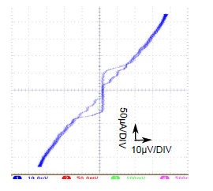
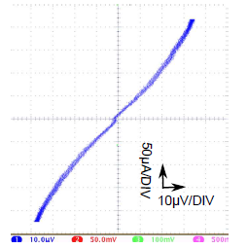

Hf-STJ development
We succeeded in observation of Josephson current by Hf-HfOx-Hf barrier layer in 2010 (S.H.Kim et. al, TIPP2011)
Hf(250nm)
Hf(350nm)
A sample in 2012
Si wafer
B=0 Gauss
B=10 Gauss
HfOx：20Torr,1hour
anodic oxidation：45nm
200×200μm²
T=80~177mK
I_{c}=60μA
I_{leak}=50μA@V_{bias}=10μV
R_{d}=0.2Ω
However, to use this as a detector, much improvement in leak current is required. ($I_{leak}$ is required to be at pA level or less)

Slide 20
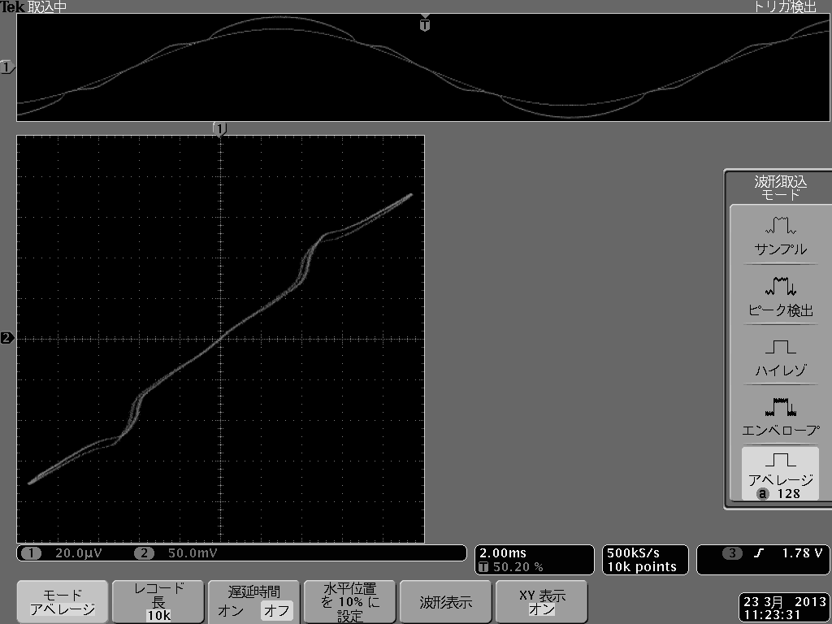
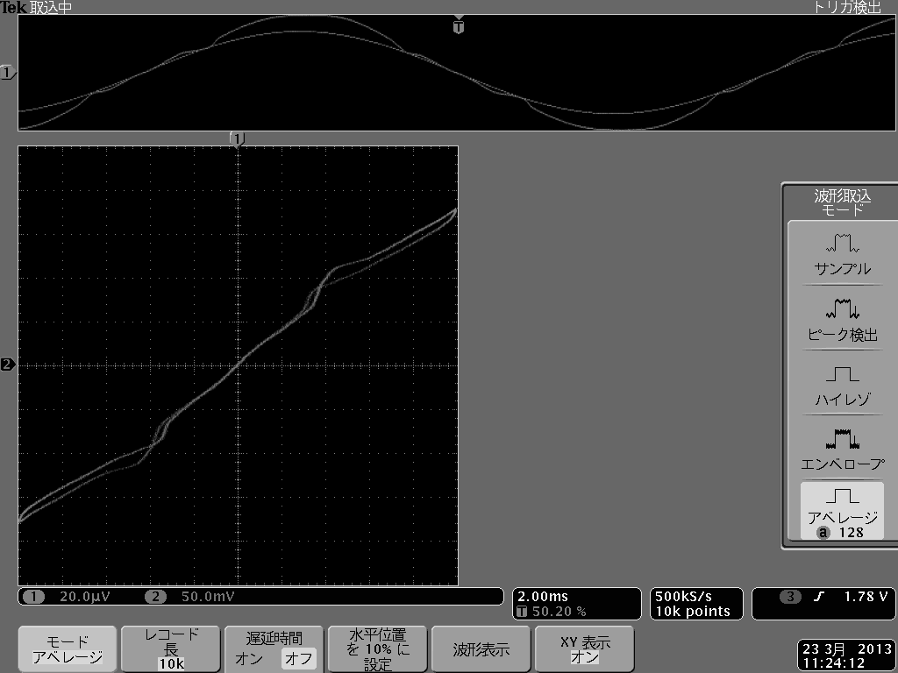
Hf-STJ Response to DC-like VIS light
Laser pulse: 465nm, 100kHz
Laser ON
I
~10μA
Laser OFF
V
10uA/100kHz=6.2×10⁸e/pulse
50μA/DIV
20μV/DIV
We observed an increase of tunnel current in Hf-STJ response to visible light

Slide 21
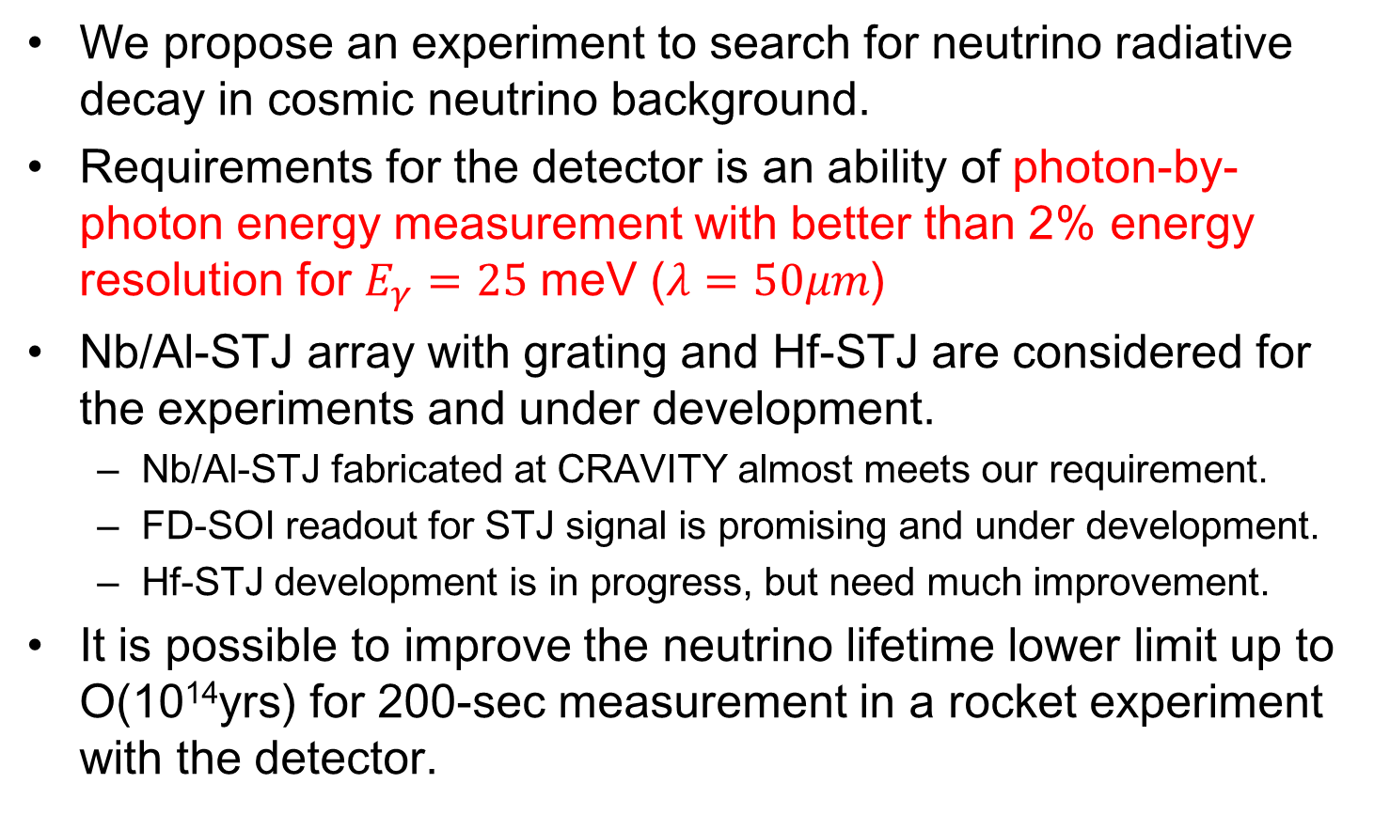
Summary
We propose an experiment to search for neutrino radiative decay in cosmic neutrino background.
Requirements for the detector is an ability of photon-by-photon energy measurement with better than 2% energy resolution for $E_{γ}=25$ meV ($λ=50μm$)
Nb/Al-STJ array with grating and Hf-STJ are considered for the experiments and under development.
  Nb/Al-STJ fabricated at CRAVITY almost meets our requirement.
  FD-SOI readout for STJ signal is promising and under development.
  Hf-STJ development is in progress, but need much improvement.
It is possible to improve the neutrino lifetime lower limit up to O(10¹⁴yrs) for 200-sec measurement in a rocket experiment with the detector.

Slide 22
Backup

Slide 23
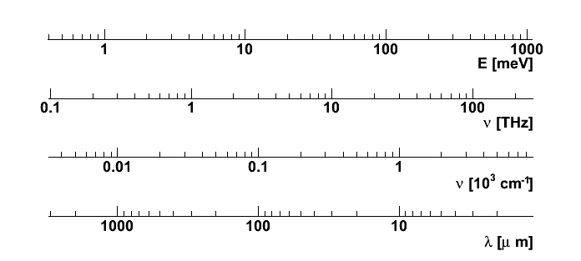



Energy/Wavelength/Frequency
$$E_{γ}=25 meV$$
$$ν=6 THz$$
$$λ=50μm$$

Slide 24


STJ I-V curve
Sketch of a current-voltage (I-V) curve for STJ
The Cooper pair tunneling current (DC Josephson current) is seen at V = 0, and the quasi-particle tunneling current is seen for |V|>2Δ
$$2Δ$$
B field
Leak current
Josephson current is suppressed by magnetic field

Slide 25
STJ back-tunneling effect
Quasi-particles near the barrier can mediate Cooper pairs, resulting in true signal gain
  Bi-layer fabricated with superconductors of different gaps Δ_{Nb}>Δ_{Al} to enhance quasi-particle density near the barrier
  Nb/Al-STJ Nb(200nm)/Al(10nm)/AlOx/Al(10nm)/Nb(100nm)
Gain: 2～200
Photon
Nb
Al
Al
Nb

