Slide 1

COBAND Project for Cosmic Background Neutrino Decay Search and Rocket Experiment Design
2017 Sep. 26th
Takashi Iida (Univ. of Tsukuba)
for COBAND collaboration

Slide 2


Contents
Neutrino decay
Cosmic neutrino background
COBAND experiment overview
Optical system design
Experiment schedule
Summary
Good morning everyone!!

Slide 3
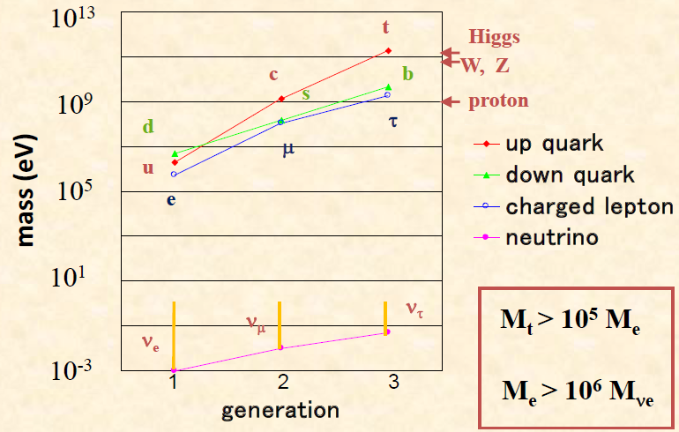
Neutrino decay
Only neutrino has unknown mass in the standard model of particle physics.
Since Δm² is known by neutrino oscillation experiment, it’s possible to determine neutrino mass by measuring Eγ of neutrino decay.
○Predicted neutrino lifetime
τ ~ O(10⁴³) [year] in the standard model
τ > 10¹⁷ [year] in the Left-Right symmetric model
※ Current experimental lower limit : τ > 10¹² [year]

Slide 4
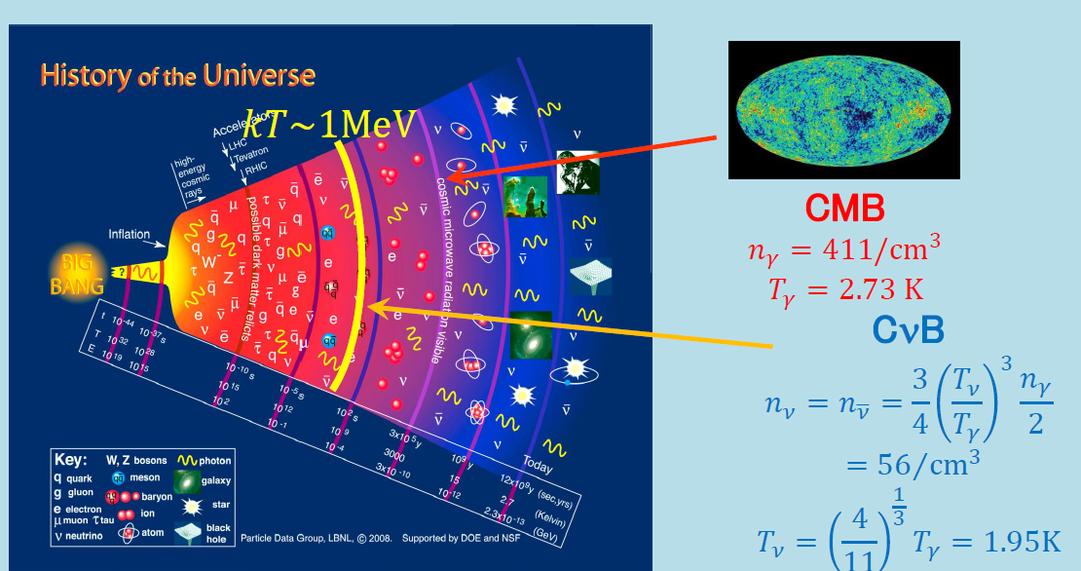
Cosmic Background Neutrino (CνB)
Our universe is filled with neutrinos originating from the Big-Bang, but they are not observed yet.
~3×10⁵ [y] after Big-Bang.
~1 [s] after Big-Bang.
We propose the COBAND project to search for neutrino decays from CνB.
Aiming τ(ν₃) = 10¹⁴ [y] by Rocket experiment in 2019,
τ(ν₃) = 10¹⁸ [y] by Satellite experiment after 2020.

Slide 5












COBAND collaboration
S.-H.Kim, Y.Takeuchi, T.Iida, K.Takemasa, K.Nagata, C.Asano, S.Yagi, R.Wakasa (U of Tsukuba), H.Ikeda, T.Wada, K.Nagase (ISAS/JAXA), S.Matsuura (Kwansei gakuin U), Y.Arai, I.Kurachi, M.Hazumi (KEK), T.Yoshida, T.Nakamura, M.Sakai, W.Nishimura (U of Fukui), S.Mima, K.Kiuchi (RIKEN), H.Ishino, A.Kibayashi (Okayama U), Y.Kato (Kindai U), G.Fujii, S.Shiki, M.Ukibe, M.Ohkubo (AIST), S.Kawahito (Shizuoka U), E.Ramberg, P.Rubinov, D.Sergatskov (FNAL), S.-B.Kim (Seoul National U)
COBAND collaboration

Slide 6


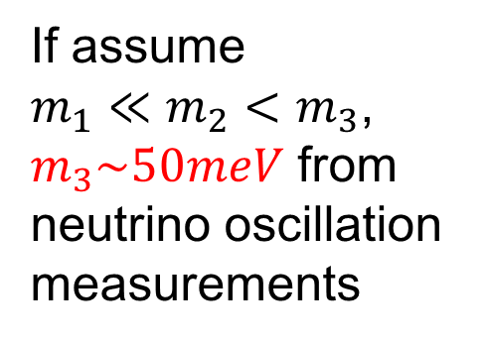
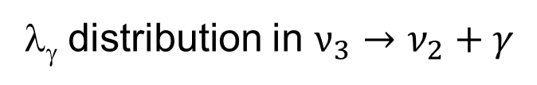
Expected photon wavelength spectrum from CνB decays
λ_{γ} distribution in $ν_{3}→ν_{2}+γ$
If assume
$m_{1}≪m_{2}<m_{3}$,
$m_{3}\sim 50meV$ from neutrino oscillation measurements
Sharp Edge with 1.9K smearing
$$m_{3}=50 meV$$
Red Shift effect
λdNγ/dλ(a.u.)
10
100
500
λ[μm]
100
50
20
10
5
E_{γ} [meV]
$$50μm(25meV)$$
No other source has such a sharp edge structure!!

Slide 7

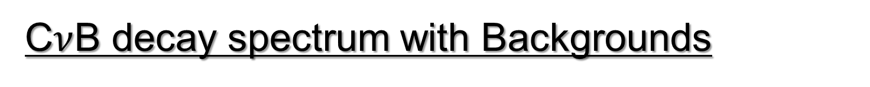
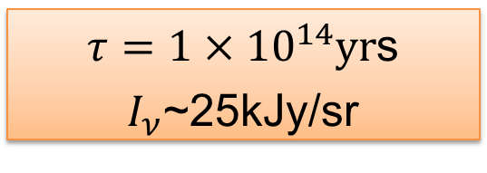
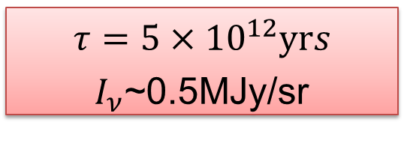
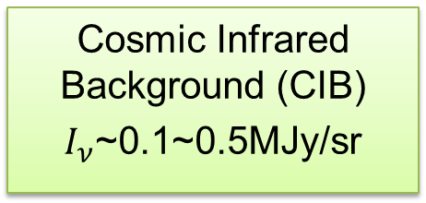
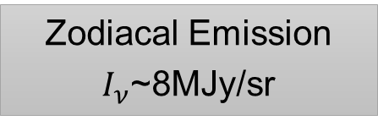
C$ν$B decay spectrum with Backgrounds
100
ZE
CMB
Zodiacal Emission
$I_{ν}$~8MJy/sr
10
AKARI
COBE
1
Cosmic Infrared Background (CIB)
$I_{ν}$~0.1~0.5MJy/sr
ZL
Surface brightness I_{ν} [MJy/sr]
0.1
0.01
ISD
CνB decay
CνB decay
0.001
DGL
$τ={5×10}^{12}yrs$
$I_{ν}$~0.5MJy/sr
SL
0.0001
1000
1
10
100
wavelength [μm]
Excluded (S.H.Kim 2012)
1000
500
200
100
50
20
10
5
2
E_{γ} [meV]
$τ={1×10}^{14}yr$s
$I_{ν}$~25kJy/sr
Expected $E_{γ}$spectrum
for $m_{3}=50meV$
Next target!!

Slide 8
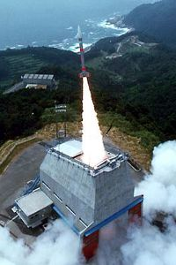
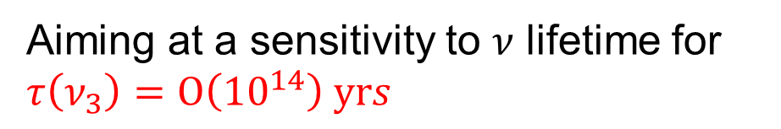
Proposal for COBAND Rocket Experiment
Aiming at a sensitivity to 𝜈 lifetime for $τ\left(ν_{3}\right)=Ο\left({10}^{14}\right) yrs$
  JAXA sounding rocket S-520
    Diameter: 520mm
    Payload: 100kg
    Altitude: 300km
    http://global.jaxa.jp/projects/rockets/s_rockets/
200-sec measurement at altitude of 200~300km in 2019
    Telescope with diameter of 15cm and focal length of ~1m
    All optics (mirrors, filters, shutters and grating) will be cooled at ~1.8K

Slide 9
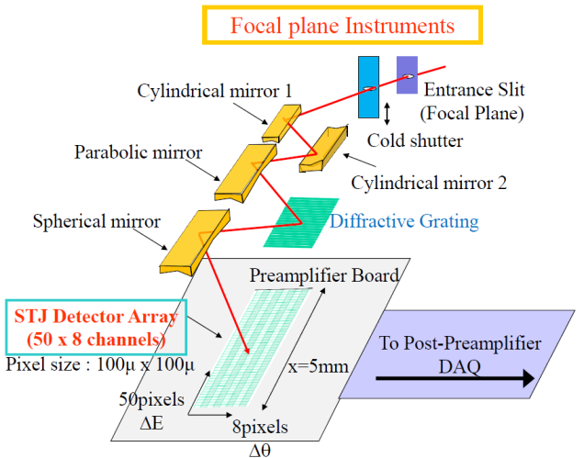
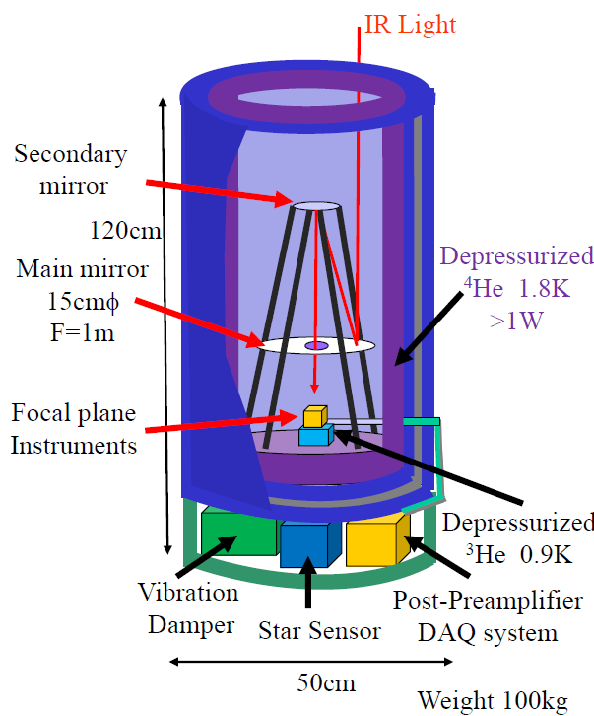


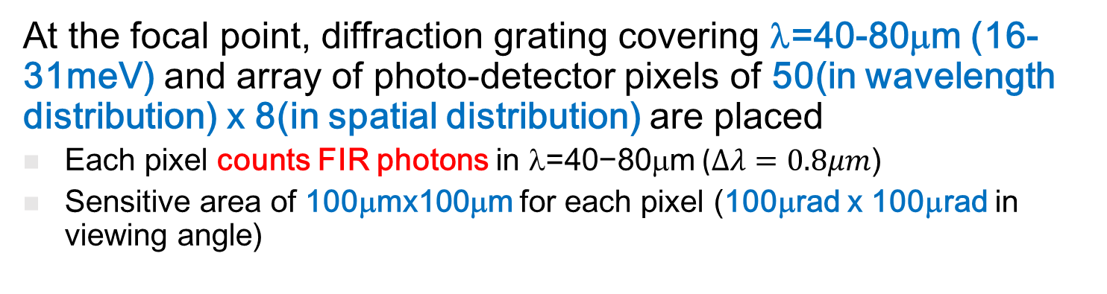
Proposal for COBAND Rocket Experiment
  At the focal point, diffraction grating covering λ=40-80μm (16-31meV) and array of photo-detector pixels of 50(in wavelength distribution) x 8(in spatial distribution) are placed
Each pixel counts FIR photons in $\text{}\text{=40−80}\text{μ}\text{m}$ ($Δλ=0.8μm$)
Sensitive area of 100μmx100μm for each pixel (100μrad x 100μrad in viewing angle)
Nb/Al-STJ array
$$Δθ$$
$$λ$$
8 rows
50 columns

Slide 10
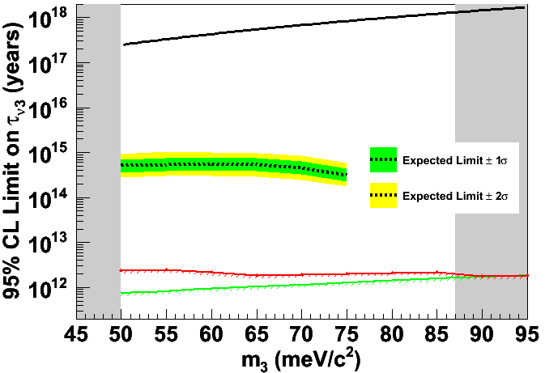

Sensitivity to neutrino decay
Parameters in the rocket experiment simulation
telescope dia.: 15cm
50-column (λ: 40μm – 80 μm) × 8-row array
Viewing angle per single pixel: 100μrad × 100μrad
Measurement time: 200 sec.
Photon detection efficiency: 100%
Excess due to Neutrino Decay
m(ν3)=50meV, τ(ν3)=2×10¹⁴y
L-R SM ζ=0.02, M(W₂)=715GeV
∑m_{i} < 0.23eV
Δm₃₁² = 2.5×10⁻³eV²
COBAND rocket
200sec meas.
Zodiacal Emission
S.H.Kim et. al (2012)
50 60 70 80
λ（μm)
Mirizzi et. al (2007)
If ν₃ lifetime were 2 × 10¹⁴ yrs, the signal significance is at 5σ level

Slide 11

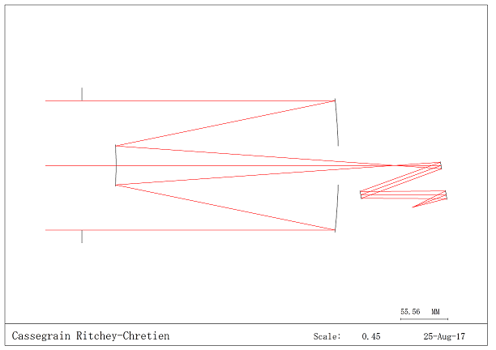
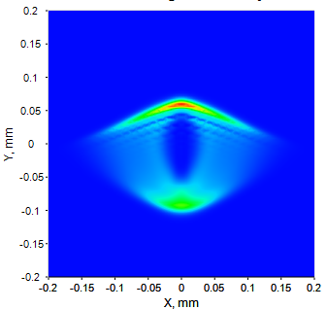
COBAND optical system design
COBAND optical system has been simulated by optical simulator (CODE-V).
Collect light by Cassegrain-Ritchey telescope
Disperse light by diffractive grating
Count photon by STJ array at the end
Simulated COBAND optical system
Simulated aberration at the focal point.
(under improvement)
Main mirror
Secondary mirror
Diffractive grating
STJ array
200μm
We are now trying to reduce aberration within 100 μm, size of STJ.

Slide 12
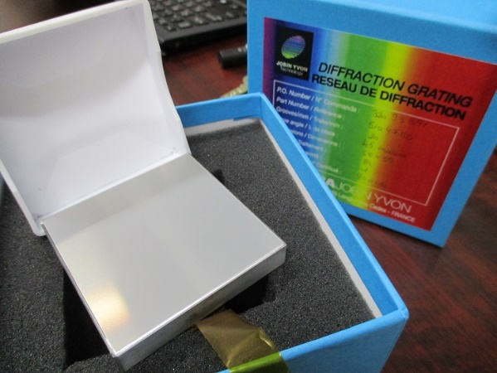
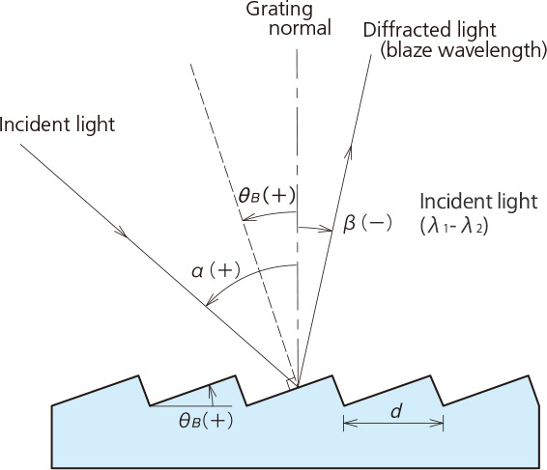
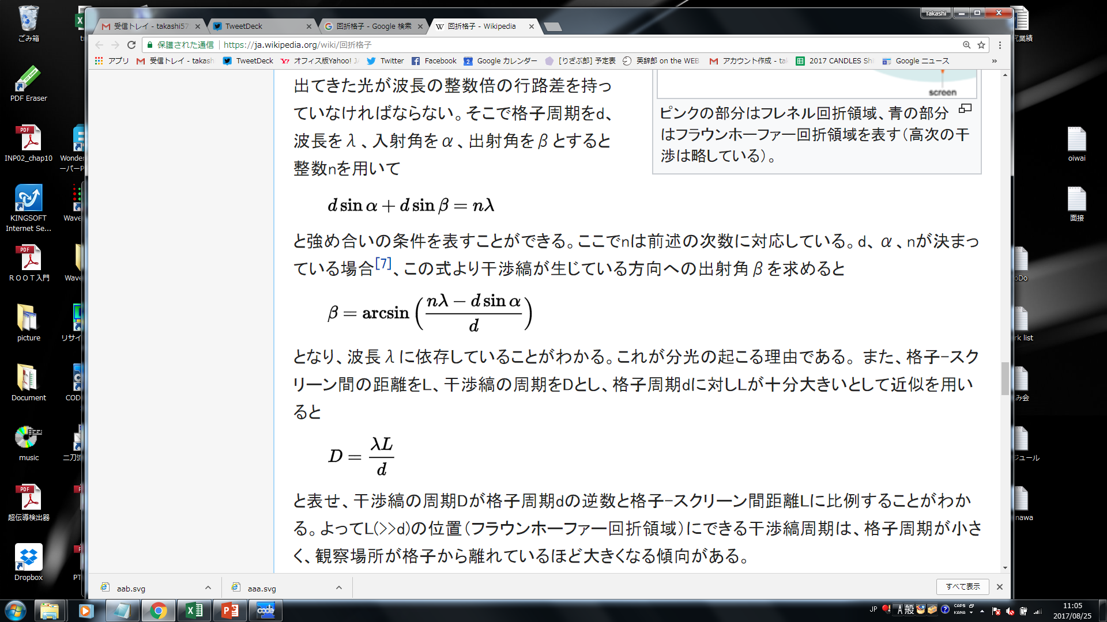
Diffractive grating
One of the most important part in COBAND.
Ordered a diffractive grating for HORIBA Ltd..
  Size ： 50mm × 50mm×6mm
  Blaze length ： 45μm
  Blaze angle ：26°45′
  Interval of groove : 50μm
α: Incident angle
β: Reflected angle
d: Interval of groove
λ: Wavelength
α=45° d=50μm n=1
λ [μm] | β [degree]
40 μm | 5.3°
60 μm | 29.5°
80 μm | 63.2°
It’s possible to disperse 40-80 μm light by grating!!

Slide 13
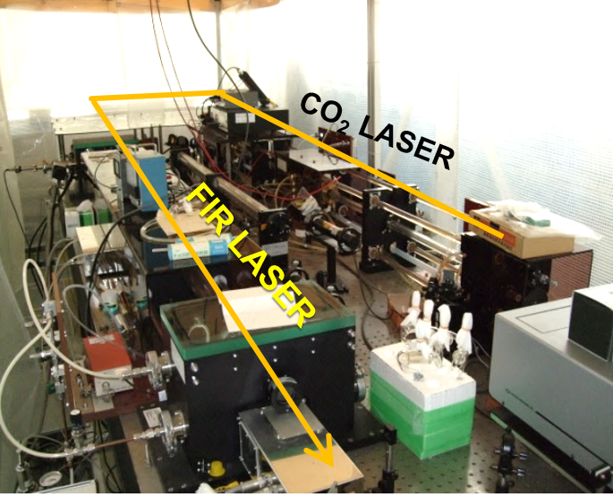
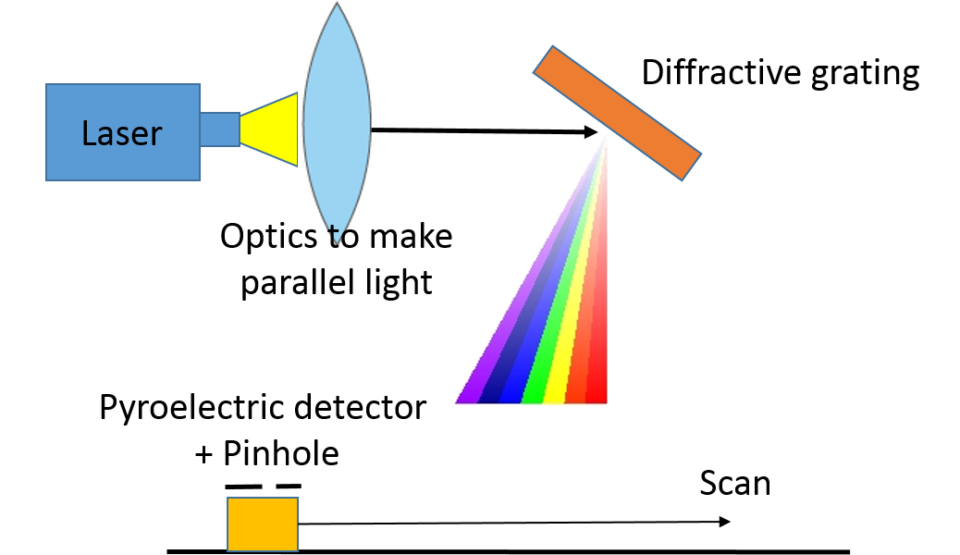
Grating test at Fukui Univ.
Far-infrared molecular laser apparatus at FIR-UF (Univ. of Fukui)
We plan to use this FIR laser for a test of diffractive grating in 2017.
Setup for grating test
Available laser wavelength @Fukui
Wavelength | Molecule | Output
43.7 μm | CD₃OH | -
52.9 μm | CD₃OH | 4.2 mW
57.2 μm | CH₃OD | 72 mW
86.4 μm | CD₃OH | -
Measure the grating performance and confirm that 2% resolution is possible with this grating and 100μm STJ.

Slide 14
Schedule of COBAND project
Japanese FY | 2016 | 2017 | 2018 | 2019 | 2020 | 2021
Setup design
STJ detector
Cryogenic electronics, readout circuit
Optics
Rocket-borne refrig.
Measurement Analysis
Satellite exp.
Rocket exp.
Nb/Al-STJ
（ＳＯＩ-ＳＴＪ） R&D
Production
Hf-STJ R&D
Nb/Al-STJ設計・開発
Rocket exp.
R&D
Production
Design
Design
Production
Design
Design
Production
Design
Analysis tool devel.
Analysis
Simulation

Slide 15
Summary
We propose the COBAND experiment which searches for cosmic background neutrino decay.
Aiming τ(ν₃) = 10¹⁴ [y] by Rocket experiment in 2019,
τ(ν₃) = 10¹⁸ [y] by Satelｌite experiment after 2020.
※ Current experimental upper limit : τ > 10¹² [year]
Now we are developing the system with Nb/Al-STJ by AIST and diffractive grating in order to measure the spectrum for 40 – 80 μm region.
Performance of the system will be tested using FIR-laser @Fukui and we feedback the result to the detector design.
Everything will be ready by early 2019!!

Slide 16


Backup
Thank you everyone!!

Slide 17
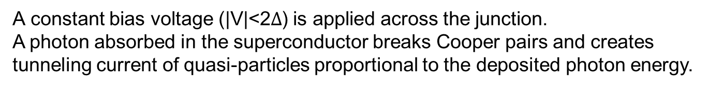
Superconducting Tunnel Junction (STJ) Detector
Highly sensitive STJ makes us possible to detect FIR photon.
Superconductor / Insulator /Superconductor Josephson junction device
E
Superconductor
2Δ
Insulator
300nm
N_{s}(E)
100μm
Superconductor
Superconductor
Insulator
Δ: Superconducting gap energy
A constant bias voltage (|V|<2$Δ$) is applied across the junction.
A photon absorbed in the superconductor breaks Cooper pairs and creates tunneling current of quasi-particles proportional to the deposited photon energy.
Much lower gap energy (Δ) than FIR photon ➔ Can detect FIR photon
Faster response (~μs) ➔ Suitable for single-photon counting

Slide 18

STJ energy resolution
Signal = Number of quasi-particles : $N_{q.p.}=G\frac{E_{γ}}{1.7Δ}$
Resolution = Statistical fluctuation in number of quasi-particles
$σ_{E}=\sqrt{\left(1.7Δ\right)FE}$
Δ: Superconducting gap energy
F: Fano factor
E: Photon energy
G: Back-tunneling gain
Nb/Al-STJ
Well-established
Δ~0.6meV by the proximity effect from Al
Operation temperature <400mK
Back-tunnelling gain G~10
N_{q.p.}=25meV/1.7Δ×10~ 250 σ_{E}/E~0.1 for E=25meV
25meV single-photon detection is feasible in principle
※Detail of the STJ development will be presented by Takemasa-kun (after the next speaker)
Notes:
18

