Slide 1

Heavy-Flavour Physics in Heavy-Ion Collisions
Shingo Sakai (Univ. of Tsukuba)
Notes:
I talk about heavy-flavour production, especially via electrons and muons

Slide 2
Heavy quarks in heavy-ion collisions
The goal of the relativistic heavy-ion collisions (HIC)
  Create & study the hot and dense QCD matter,
  Quark-Gluon plasma (QGP), which is a state of matter
  a few μs after Big-Bang
Heavy flavour (c & b) production
in heavy-ion collisions
  Created in initial parton-parton
  scattering, and traverse and interact with QGP
    1/2m_{c} (~0.07 fm/c) < QGP formation (~0.1-1fm/c)
    << QGP life (10 fm/c)
    Ideal probe to investigate properties of QGP
D, B, e, μ
jet
charm
beauty

Slide 3
Nuclear modification factor (R_{AA}) and elliptic flow (v₂)
Nuclear modification factor (R_{AA})
  R_{AA} < 1: suppression of yields w.r.t. pp collisions
  Due to energy loss of parton via radiative and/or collisional process
  Mass & colour charge dependence of energy loss
Elliptic flow (v₂)
  dN/d(φ-ψ_{RP}) = …+ N₀(1+2v₂cos(2(φ-ψ_{RP}))) +…
  Pressure gradient in non-central collisions (low p_{T})
    Sensitive to thermalisation of matter
Non-central

Slide 4
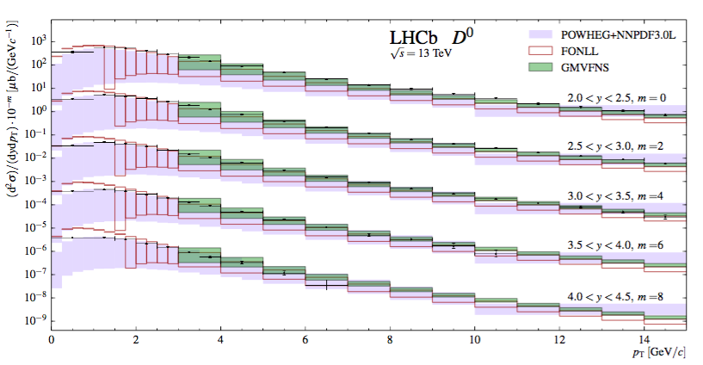
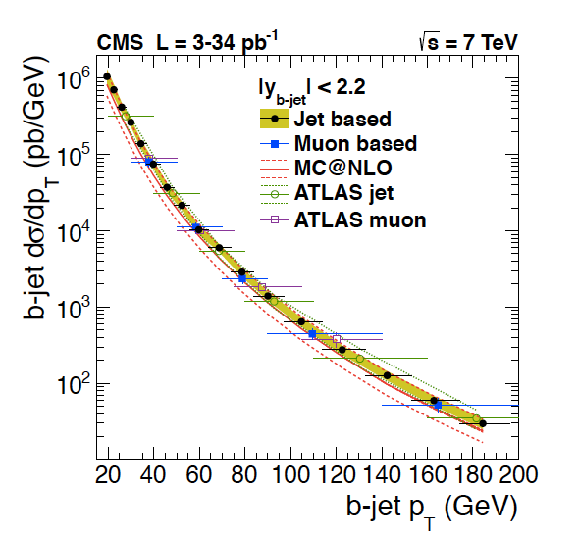
Heavy-flavour productions in pp
JHEP1603(2016)159
13 TeV
Heavy-flavour production in pp collisions
  Reference for the production in heavy-ion collisions
  Important to understand the production mechanism not only experiment
  but also theoretical calculations for HIC
Production cross sections are well described by pQCD calculations

Slide 5
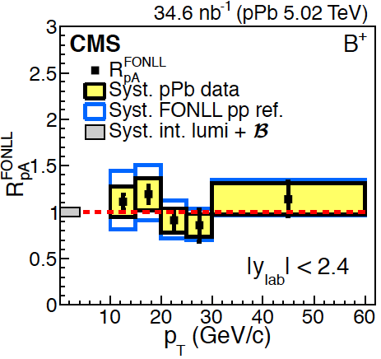
Heavy-flavour productions in pA
PRL 113 (2014) 232301
PRL 115 (2016) 032301
p-A collisions : control measurement for heavy-ion collisions to disentangle
initial (cold nuclear matter effects) from final state effects
Cold nuclear matter effects (CNM)
  Shadowing or gluon saturation (PDF), k_{T} broadening, energy loss
CNM effects on heavy flavour production is small

Slide 6
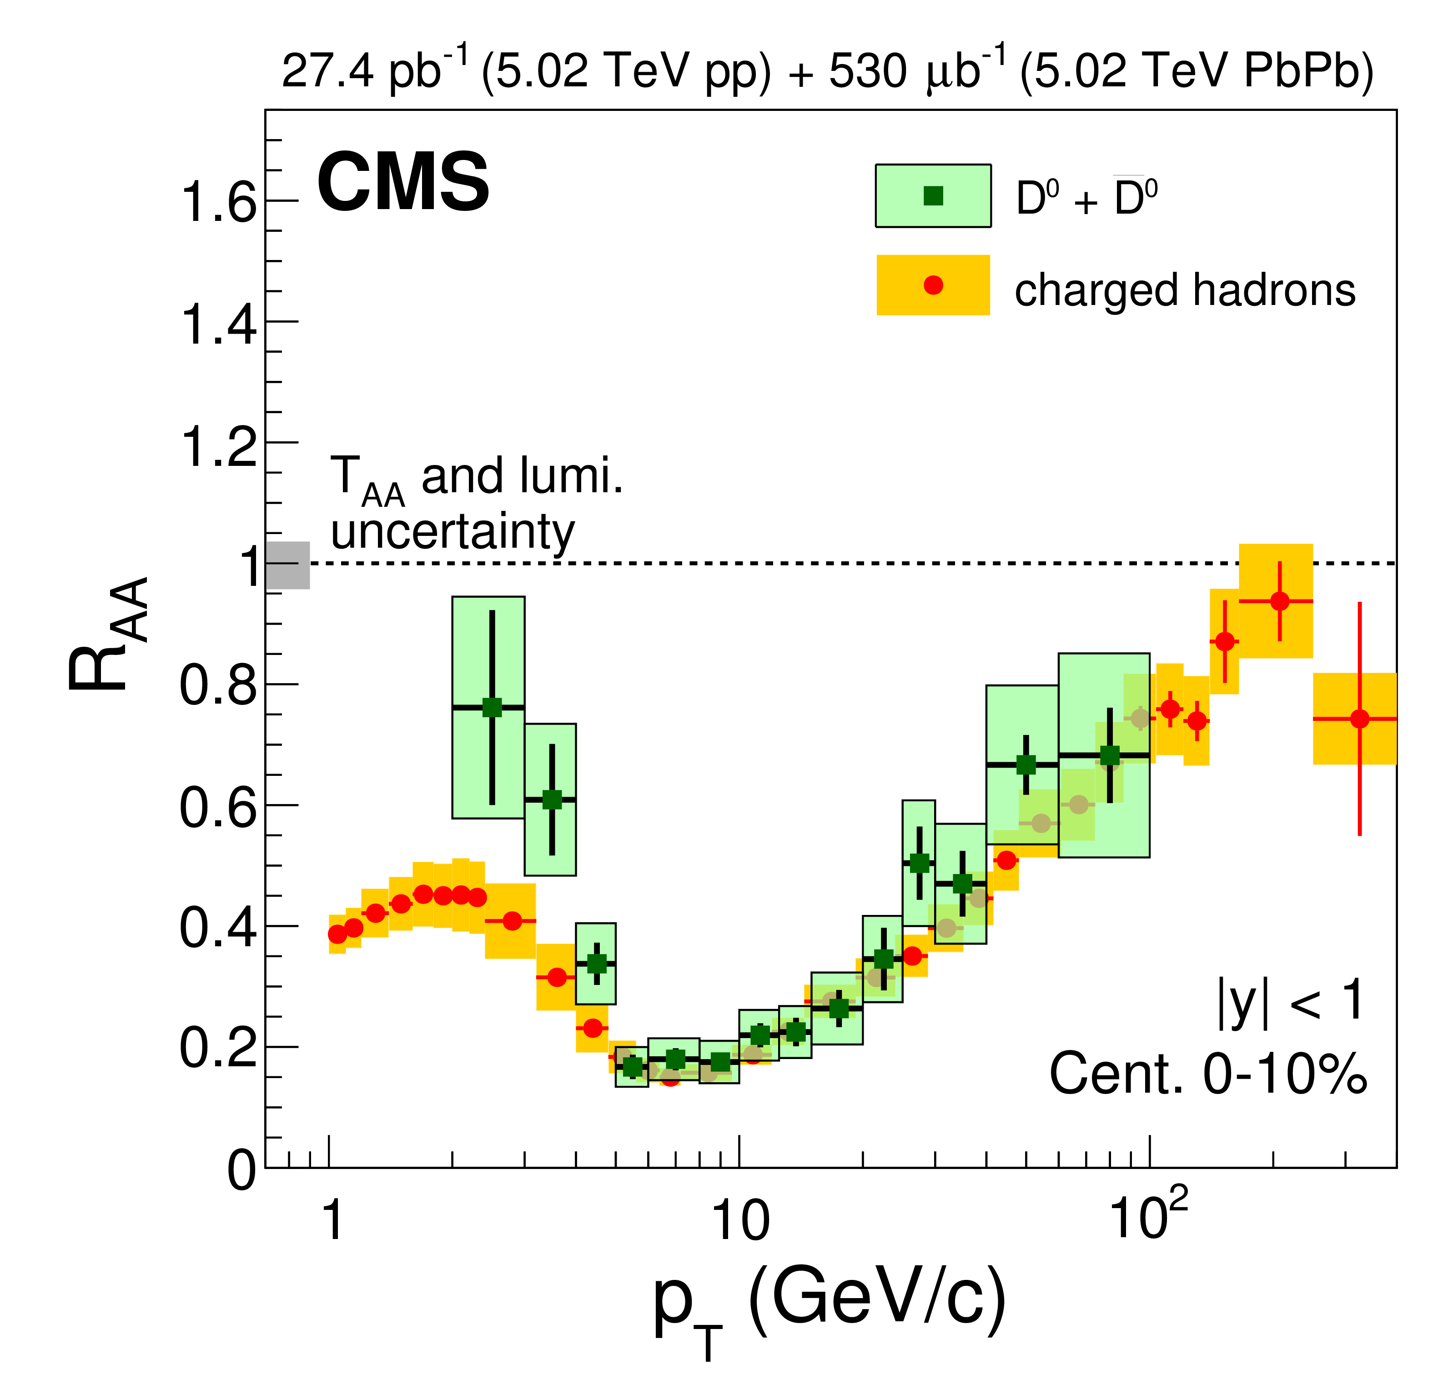
Charm production in HIC
arXiv:1708.04962 (submitted PLB)
D meson production is strongly suppressed w.r.t. pp collisions
  Similar suppression as charged hadrons (up to 80%)
  Indicate significant energy loss of charm in hot & dense QCD matter

Slide 7
Beauty production in HIC (1)
B meson production in HIC is also suppressed w.r.t pp collisions
  Indicate significant energy loss of beauty quark in hot & dense QCD matter
  B meson : heavier than D meson
  The magnitude of the suppression is smaller than pion and D meson

Slide 8
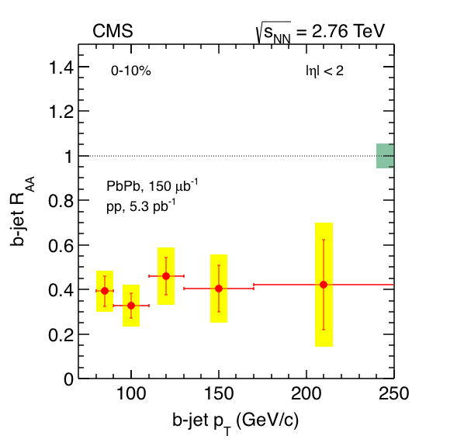
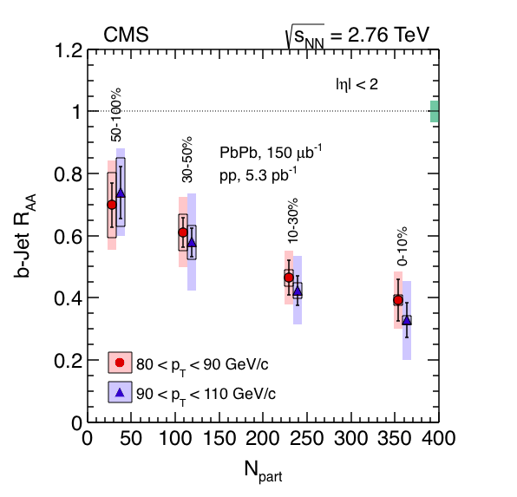
Beauty production in HIC (2)
PRL 113 (2014) 132301
Heavy-flavour jets: allow to address energy loss at parton level
Observed strong suppression of b-jets in most-central collisions
  indicate the suppression already arises parton level

Slide 9
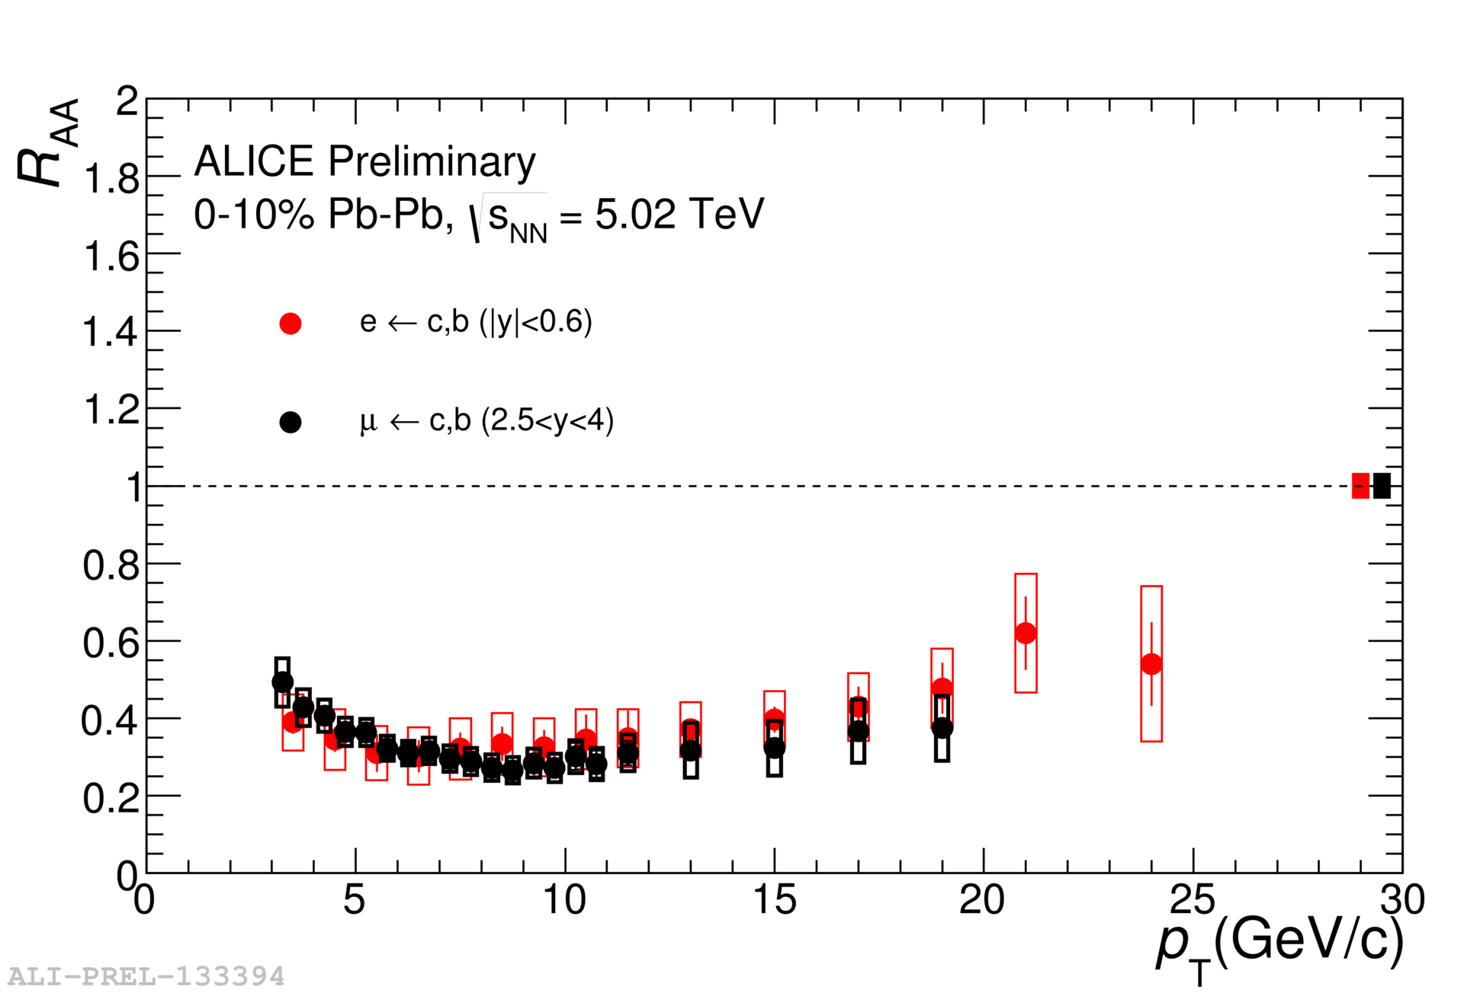
Energy and rapidity dependence of HF production in HIC
R_{AA} of electrons from heavy-flavour decays
  Similar suppression of the production 0.2 (RHIC), 2.76 and 5.02 TeV
  Similar suppression between mid- and forward-rapidity regions
  No significant energy and rapidity dependence of the suppression
Notes:
- Combination of charm and beaty decay electrons

Slide 10
Azimuthal anisotropy of D mesons
PRC 90 (2014) 034904
Non zero D v₂ at low p_{T}
Tends to get large from central (0-10%) to mid-central (30-50%)
  driving force : pressure gradient (get larger central to mid-central)
  hydro dynamical behavior
Charm quarks participate to the collective motion of the system

Slide 11
Comparison with models
JHEP09(2012)112
PRC 90 (2014) 034904
Theoretical calculations
  initial: with/without cold nuclear matter from PDF
  medium modeling: Hydro, Glauber, parton transportation
  interaction: radiative, collisional, resonant interaction
  hadronization: fragmentation, coalesence
Large suppression and non-zero v₂ (at low p_{T}) are represented by models, but simultaneous reproduction of the R_{AA} and v₂ is challenging
Notes:
So our results show that the strong suppression and positive v2 of HF.
Here is comparison of data and theoretical calculations.

Slide 12
Summary
Heavy-flavour production in pp collision is well described by pQCD calculation
Cold Nuclear Matter effects are small in heavy-flavour productions
A strong suppression of heavy-flavour production and a positive elliptic flow (v₂) are observed in heavy-ion collisions
  Charm and beauty are significantly lose their energy
  Charm quarks participate to the collective motion of the system
Heavy flavours strongly interact with hot and dense QCD
  matter formed in Pb-Pb collisions

