Slide 1
Results and Plans of the SOIPIX Collaboration
K. Hara (University of Tsukuba)
Collaboration was formed in 2005 by KEK-Universities (Y. Arai, representative) to develop monolithic pixel devices utilizing Silicon-On-Insulator technology provided by OKI Semiconductor
SOIPIX Collaboration:
KEK, U. Tsukuba, Osaka U., Tohoku U., Kyoto U., Kyoto U. of Education,
JAXA/ISAS, RIKEN, LBNL, FNAL, U. Hawaii, INP Krakow, INFN Padova, OKI Semiconductor Co. ,Ltd.
corporation with Tohoku-Micro Tech Co. ,Ltd.

Slide 2
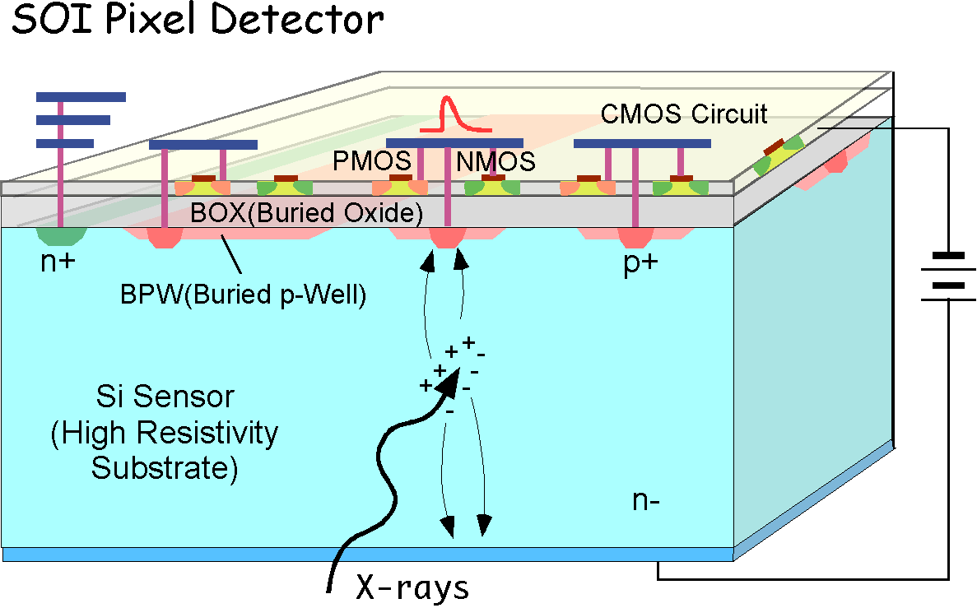
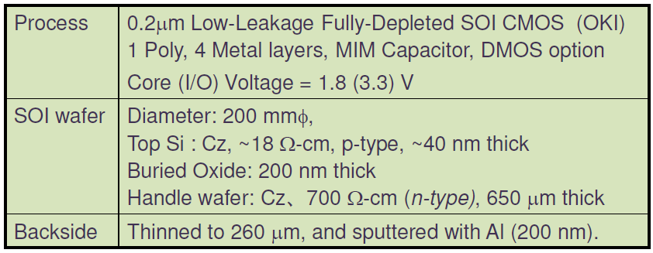
Monolithic SOI Pixel Device
Technology characteristics:
bonded SOI wafers by SOITEC Co. with high resistive (~700Ωcm) “handle wafer” for sensing part
commercial FD-SOI process (0.20μm) by OKI Semiconductor
40nmSi
200nmBOX
Pros:
monolithic
(fab. cost, small material, high density,,,)
SOI features
(low power, hi-speed, no latch-up,
4K-300C operational,,,)
Cons:
back-gate effect
(readout affected by the bias voltage)
BPW, 3D
Main process parameters:
MPW runs this year: 5 metal layers, MIM(1.5 fF/μm²)

Slide 3
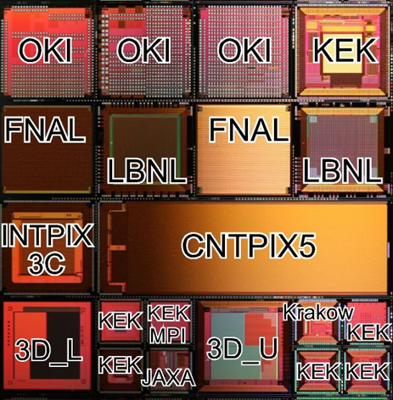
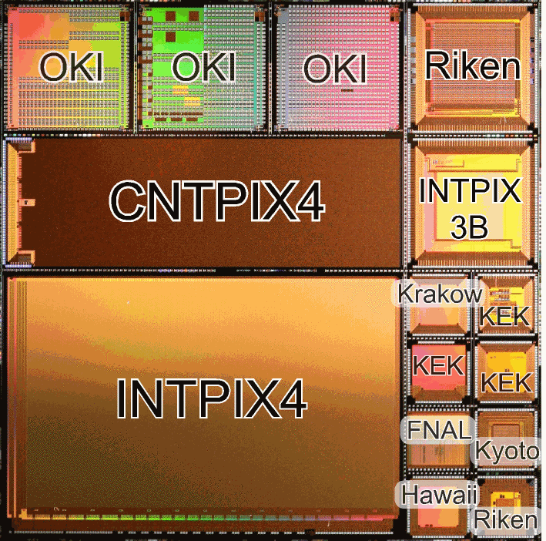
Multi-project wafer
20.8mm sq on 8” wafer
FY09-2
FY09-1
MPW:
to boost SOI device developments
3D process possible (3D_L, 3D_U)

Slide 4
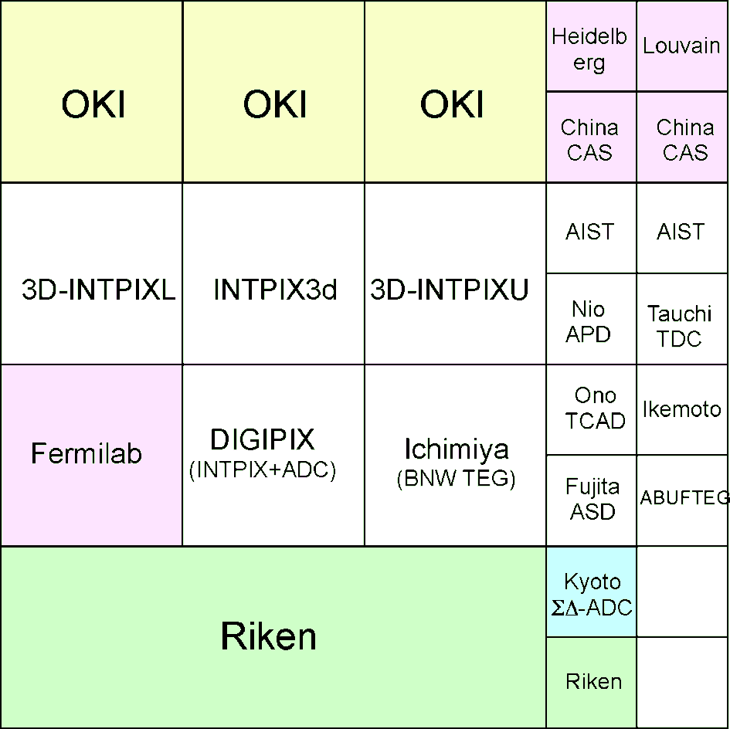
Coming MPW – layout plan -
FY09-1
We schedule twice in this FY (~Mar.2011) :
Aug.2010 & Jan.2011 submissions
We call your participation. Please visit:
http://rd.kek.jp/project/soi/MPWrun

Slide 5
SOI pixel detector development –Overview-
Two main types of pixel detectors designed by KEK:
1. Integration-Type Pixel detector (INTPIX)
2. Counting-Type Pixel detector(CNTPIX)
2005 2006 2007 2008 2009 2010
FY05
MPW
(VDEC)
PIXELTEG
(INTPIX)
FY06
MPW
0.15um
Process
INTPIX1
CNTPIX1
FY07
MPW
0.2um
Process
INTPIX2
CNTPIX2
FY08
INTPIX3
CNTPIX3
FY09-1
INTPIX3b
INTPIX4
CNTPIX4
FY09-2
INTPIX3c
CNTPIX5

Slide 6
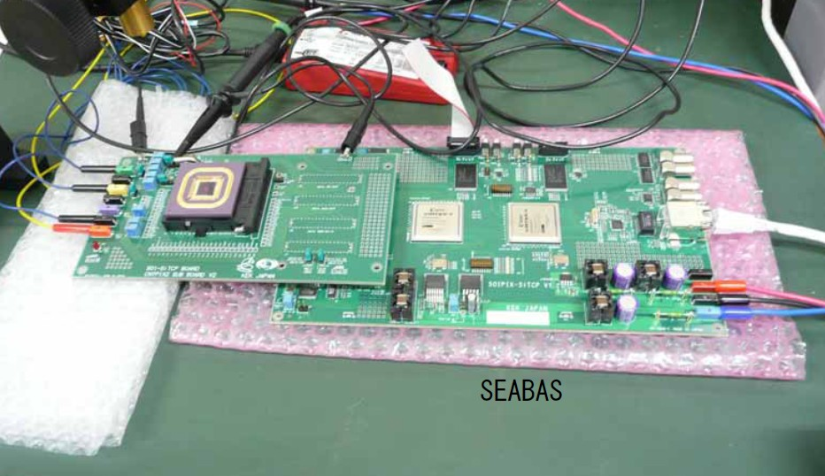
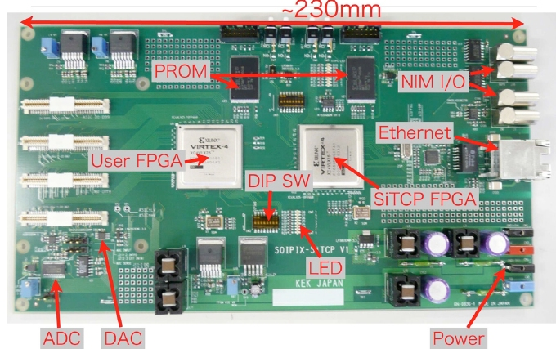
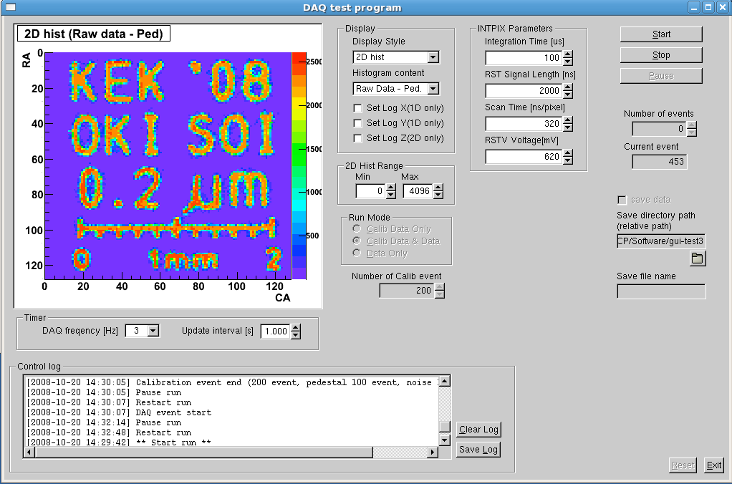
SEABAS DAQ system
All the data acquisition are done with the SEABAS
SEABAS=Soipix EvAluation BoArd with SiTCP*
-packaged chip is mounted on sub-board
-65MHz 12-bit ADC (for INTPIX)
- 4 ch 12bit DAC
-User FPGA controls
-SiTCP(network processor) for TCP/IP
-light weight DAQ system (portable)
Packaged
chip
Ethernet
sub-board
ROOT GUI software
* T. Uchida and M. Tanaka, “Development of a TCP/IP Processing Hardware”, IEEE Nuclear Science Symposium, San Diego, USA, Oct. 29 - Nov. 4, 2006, NSSproc. N33-6, 1411 – 1414.

Slide 7
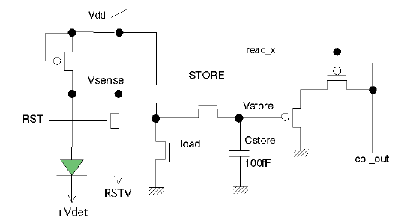
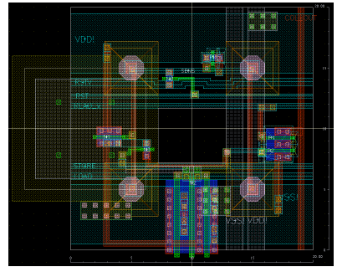
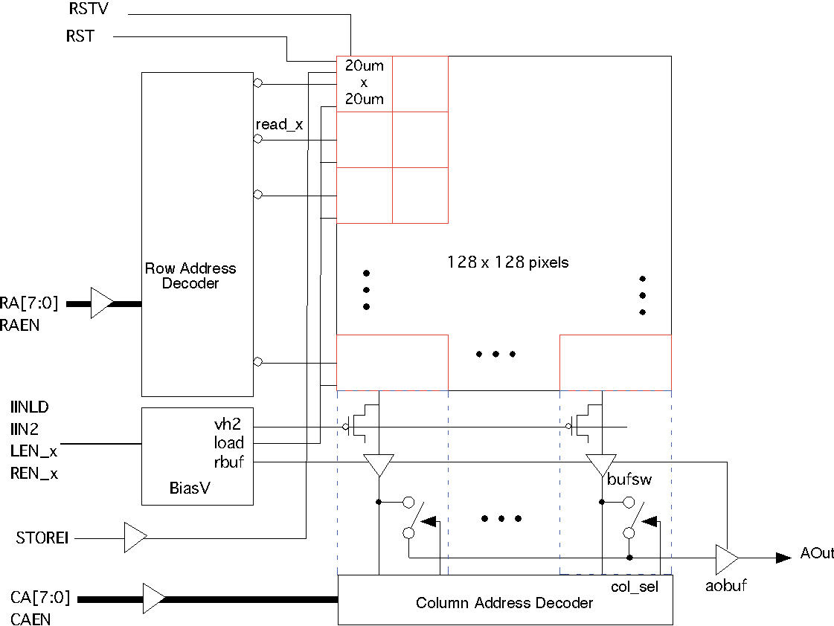
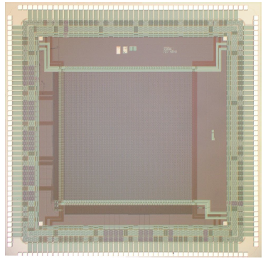
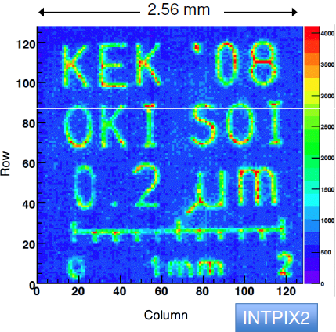
Integration type pixel (INTPIX)
APS type readout on each pixel
pixel (20x20μm) with 4 p⁺ contacts
20μm
Block diagram
INTPIX3 (128x128 pixels)
Mask image for red laser

Slide 8
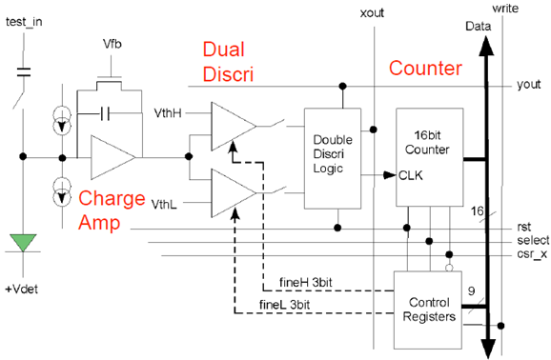
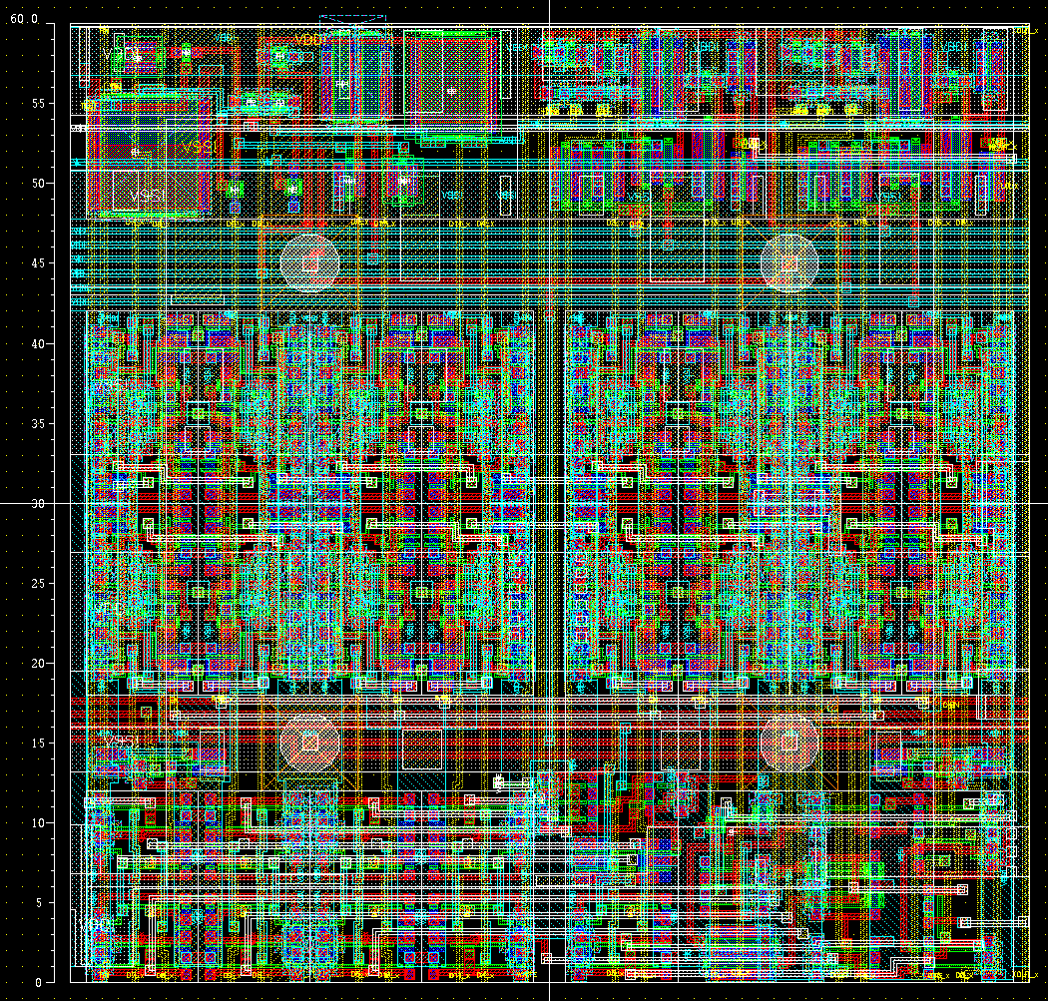
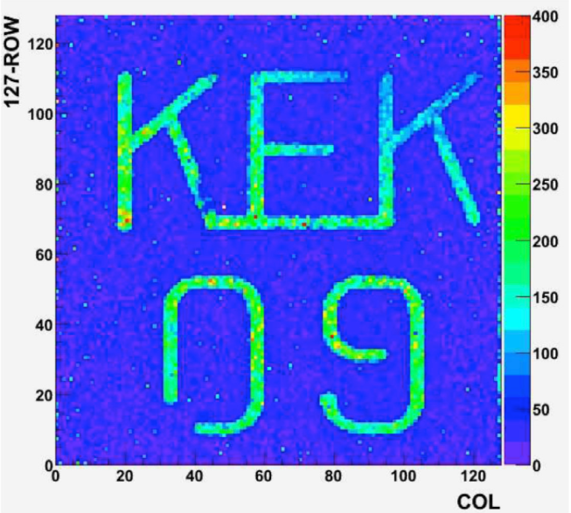
Counting type pixel (CNTPIX)
Signals within energy window (dual thresholds) are counted per pixel via a 16-bit counter (designed after Medipix2)
64um
Analog
16b
Counter
p-n junctions
CNTPIX2.1 (128x128)
Brass mask image to 8 keV X-ray
T_{int}=16μs
V_{back}=20V
9b Register
DDL
~600 transistors/pixel

Slide 9
R&D issues
Larger area (with SEABASII)
Process optimization
Optimization of BPW, including nested BWs
Cross-talk suppression
Higher bias application (electrode shape optimization)
FZ wafers (P-bulk) SOI
Wafer thinning (full depletion, backside illumination)
Lower noise (CDS)
Radiation tolerance
3D integration
CDS: Correlated double sampling

Slide 10
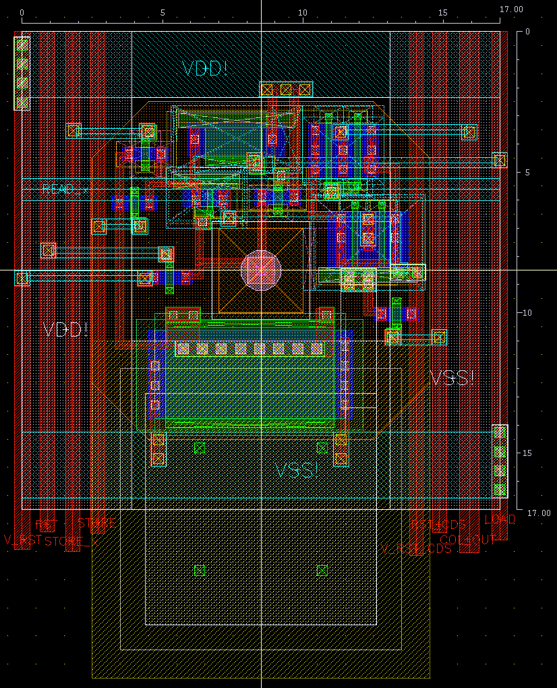
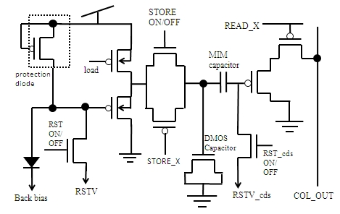
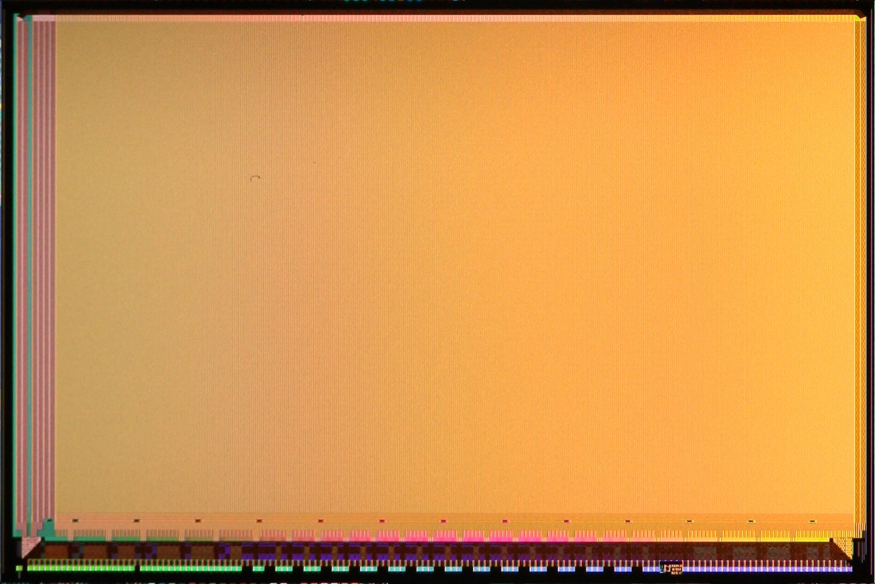
larger pixel:
INTPIX4
17μm
-Pixel size reduced to 17μm
-2 types of pixels:
Single BPW or floating BPW ring
Pixel circuit (CDS)
Single BPW
Overall: 10.2x15.4mm
- # of pixels: 512 x 832 pixels
- 13 Analog Out (13x512x64)
New readout system board (SEABAS2:Gigabit & multiple ADCs) will be used

Slide 11
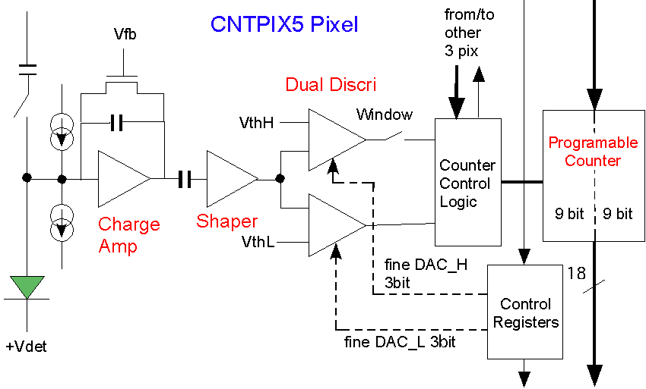
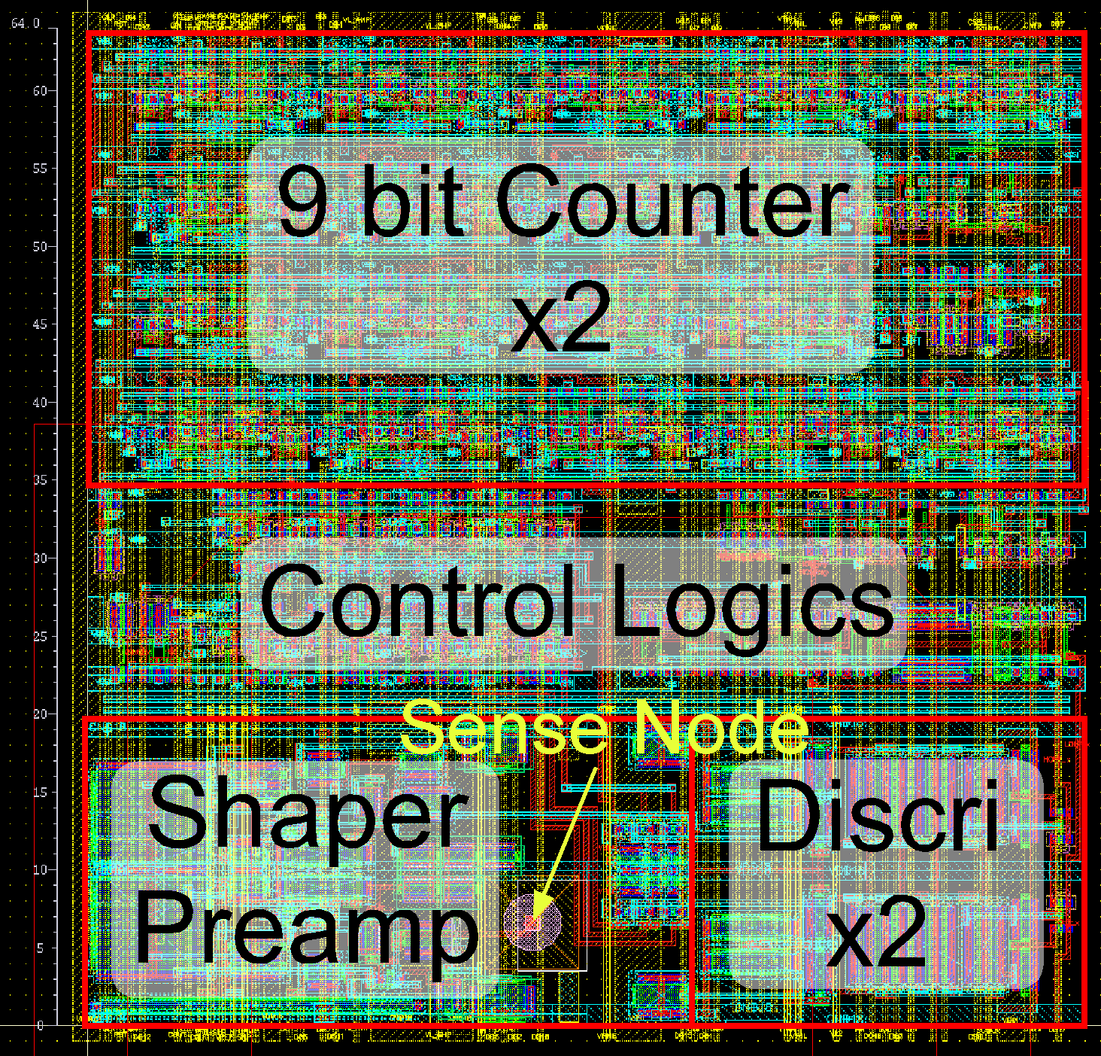
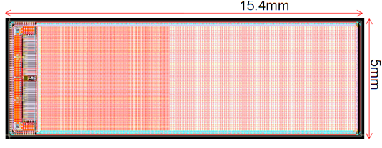
Counting Type Pixel (CNTPIX5)
pixel size: 64x64 um²
BPW in a pixel
Counter option: 9bit x 2 or 18bit
Preamplifier + Shaper
Binning mode: 2x2 pixels → 9b x 8 store
D
D
CNTPIX5
14.0x4.6mm
active area
218 x 72 pixels
1pixel (64x64μm)
Shape good for tiling
(with SEABAS2)

Slide 12
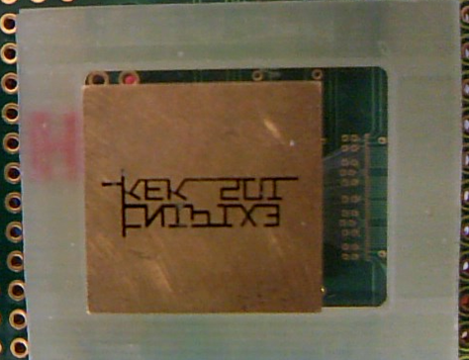
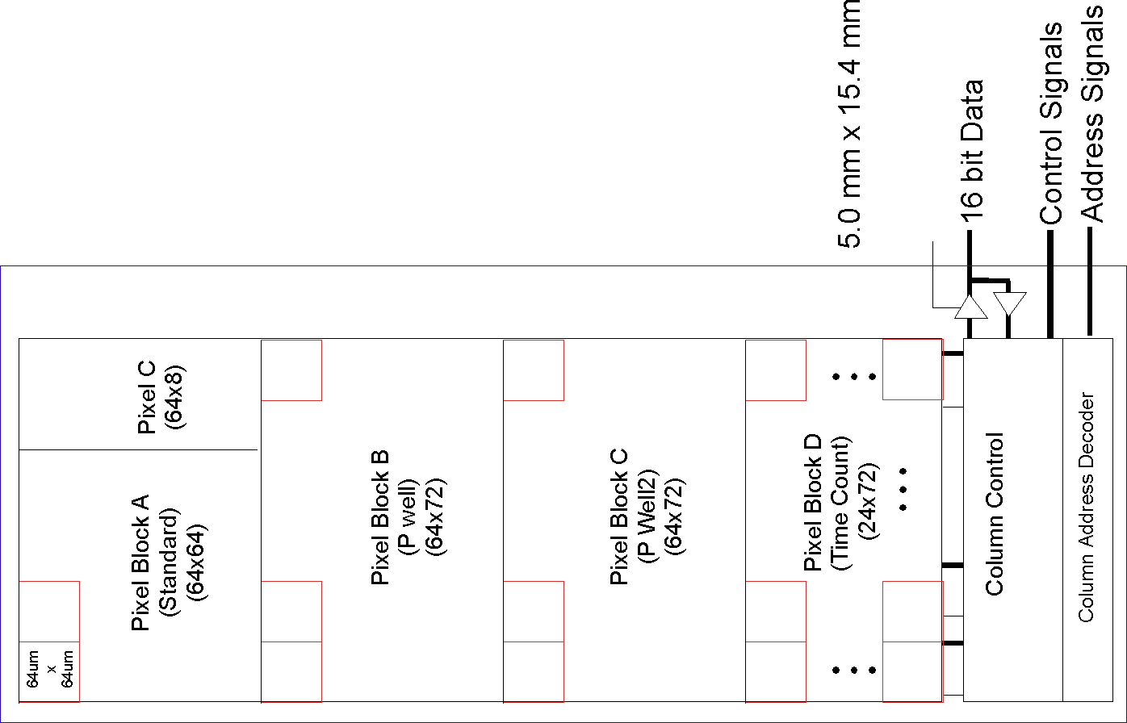
CNTPIX4 response - Red laser (635nm)
Metal mask
100
0
COL(0-71)
ROW(0-215)
- Circuit works successfully
- No major problem in the circuit
Evaluating noise level, pulse laser response (ongoing)
Evaluation of INTPIX5 is ongoing
Notes:
12

Slide 13
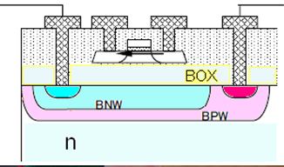
Buried p-Well (BPW) Process
Substrate Implantation
BPW Implantation
Buried
Oxide
(BOX)
SOI Si
n
Pixel
Peripheral
P+
BPW
Cut top Si and BOX, high dose
Low dose not to affect top Si
Suppress the back gate effect.
Increase break down voltage with lower dose BPW-n junction.
Less electric field in the BOX which should enhance e-h recombination, thus may improve radiation hardness.
BNW, BPW nested
(available in coming MPWs)
BNW reduces the pixel-electronics coupling
BNW could be used to compensate the radiation induced threshold shifts
(start with positive BNW, lower the voltage as positive charge is accumulated in BOX)

Slide 14
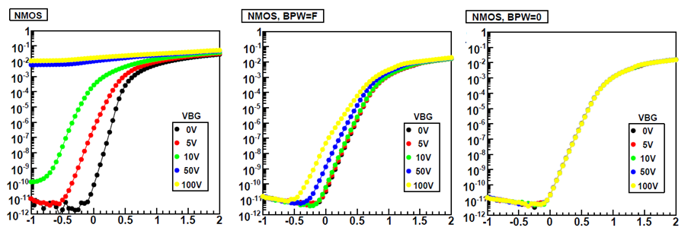
BPW effectiveness
NMOS transistor Id-Vg curves evaluated with TrTEG
Vs=0 V
Vd=1.8V
w/o BPW
w/ BPW=Floating
w/ BPW=0V
ΔVth < 3mV
Vgs [V]
Vgs [V]
Vgs [V]
Transistor characteristics is not affected by the backgate voltage up to 100V for BPW=0V.
Similar results for PMOS

Slide 15
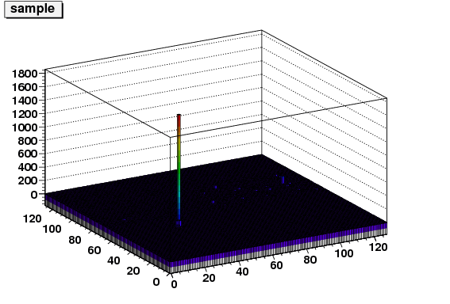
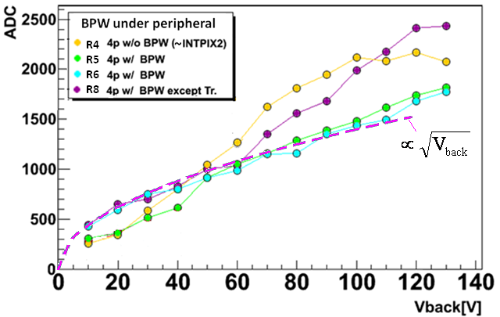
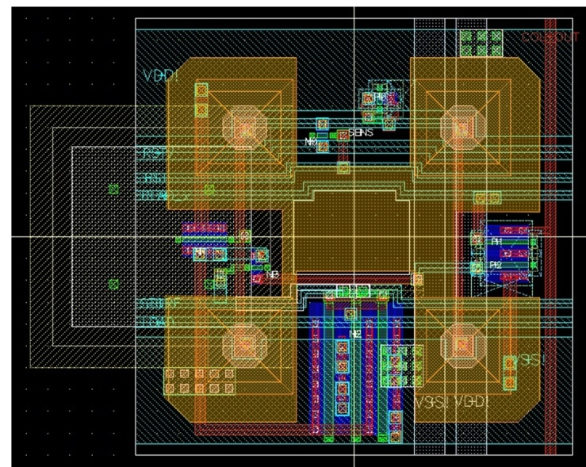
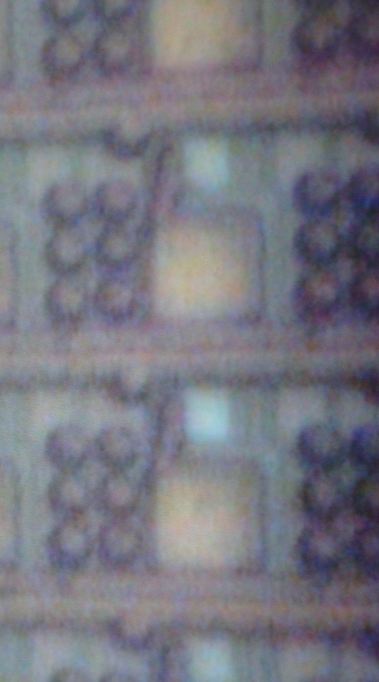
INTPIX3 (w. BPW) response to 1064nm laser
Pulsed 1064 nm YAG:Nd laser (base width~10ns)
→ penetration depth ~3mm
window
- Signal increases up to 130 V (just below breakdown )
Back-gate effect is suppressed
BPW only under the peripheral circuit R4 reduces the effect…
focused inside
K. Hara - VERTEX2010, 6-11 June, Loch Lomond, Scotland

Slide 16
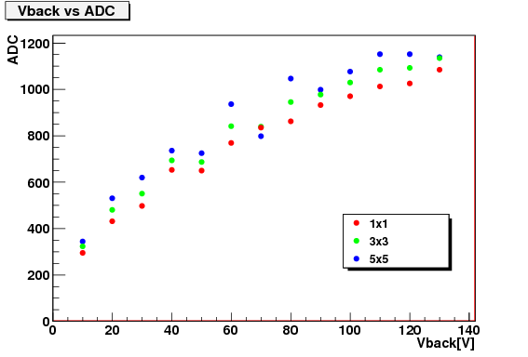
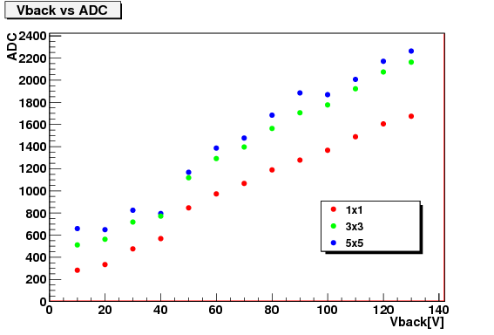
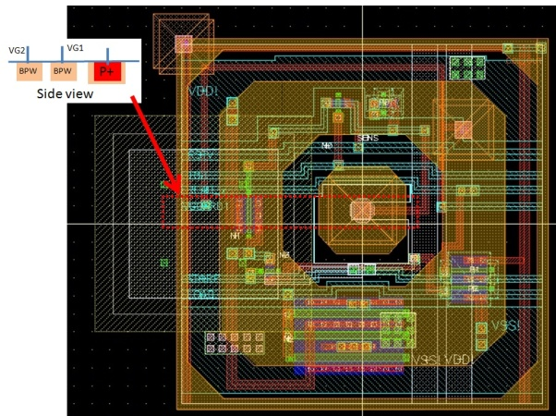
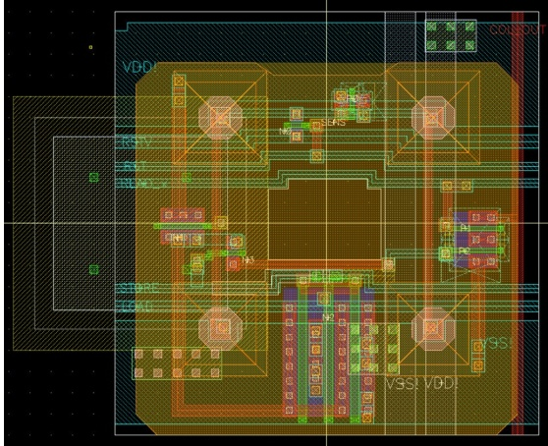
Cross-talk: BPW design for pixels
region 1
region 5
p+
p+
While injecting laser to one pixel,
adding neighbors (3x3) increases notably in region 5
adding further neighbors (5x5) stays similar
separate BPW electrodes
large BPW electrode tied to the readout p-implants

Slide 17
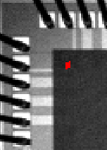
Higher bias application
<IR camera>
corner of NS ring is weakest
Better with sq->oct and/or wo->w BPW
Circle is available in coming MPWs

Slide 18
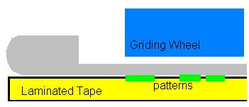
Wafer thinning by DISCO-TAIKO
OKI-semi process on 725μm thick 8” wafer
Usual chips: thinned to 260μm and Al sputtered on back
One wafer (incl. INTPIX2) thinned to 106 μm by DISCO Co.
process: TAIKOTM grinding + chemical etching
No backside aluminization tried
Full depletion expected at 60 V
From DISCO web:
Grind leaving an edge ~3mm
50um thickness possible for 8”
negligible grind-originate warp
zero edge chipping
self sustainable
easier handling
post process possible
TAIKO=drum
Photo: http://www.disco.co.jp/jp/solution/library/taiko.html

Slide 19
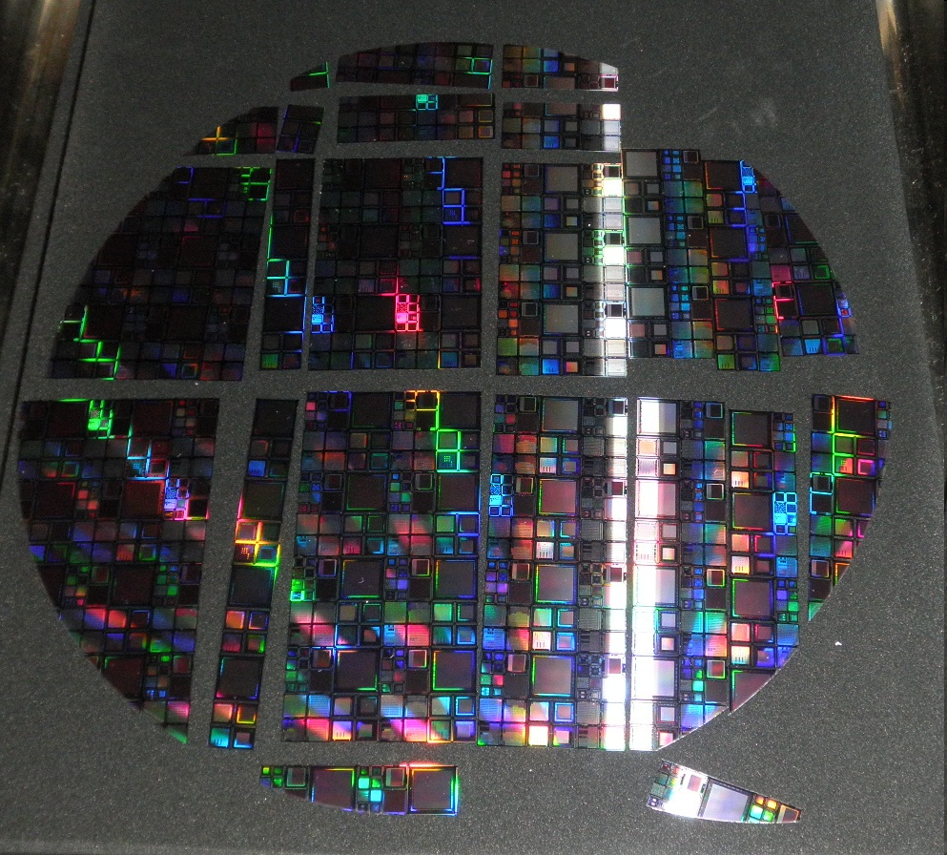
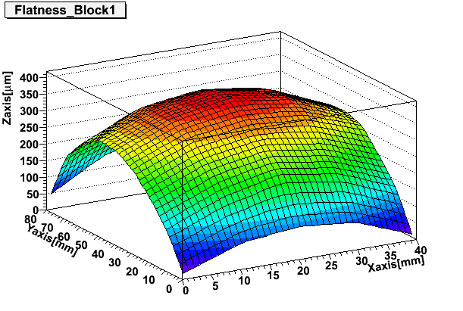
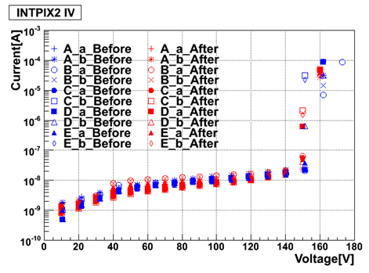
Thinned wafer and chips
Typical profile (0.4 mm max for 40x80 mm block)
Warp introduced by residual strain caused by
CTE difference between Si and SiO₂
IV of 5 INTPIX2 chips (A-E) compared
before(690um) and after(105um)
Small change in leakage current plateau
Small change in breakdown onset voltage

Slide 20
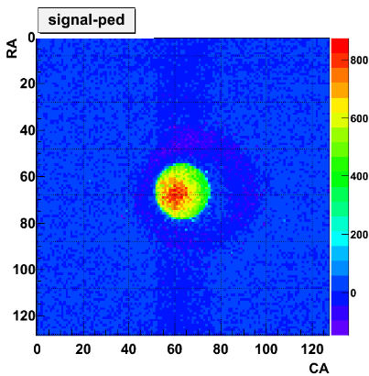
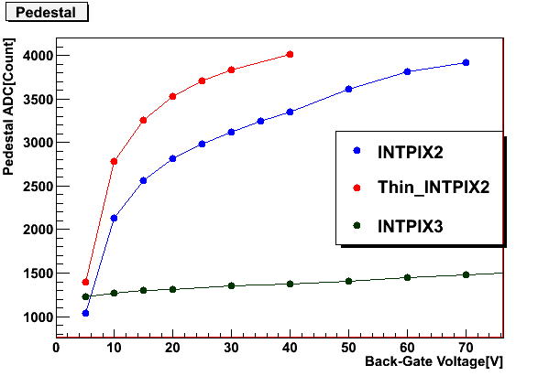
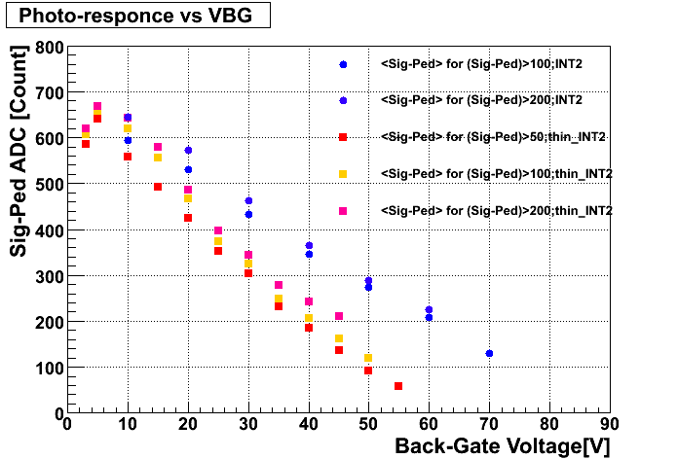
Thinned INTPIX2 response
Thinned INTPIX2 responded properly
This is our first successfully thinned chip
INTPIX2(105um)
INTPIX2(260um)
Pedestal shifts
Larger shift due to back-gate effect, although substantial in INTPIX2 of normal thickness.
INTPIX3(260um)
0 10 20 30 40 50 60 70
Vback[V]
Response to white light
(pedestal adjusted)
Quicker decrease in thin INTPIX2
- Flat response expected if no back-gate effect
INTPIX2(105um)
INTPIX2(260um)
Thinning INTPIX3 wafer is in progress, where we expect to observe full depletion

Slide 21
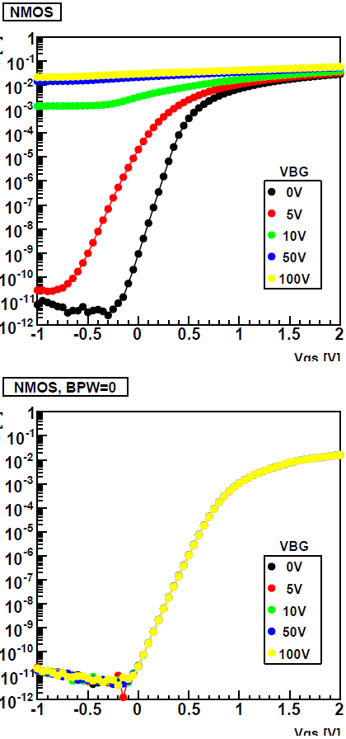
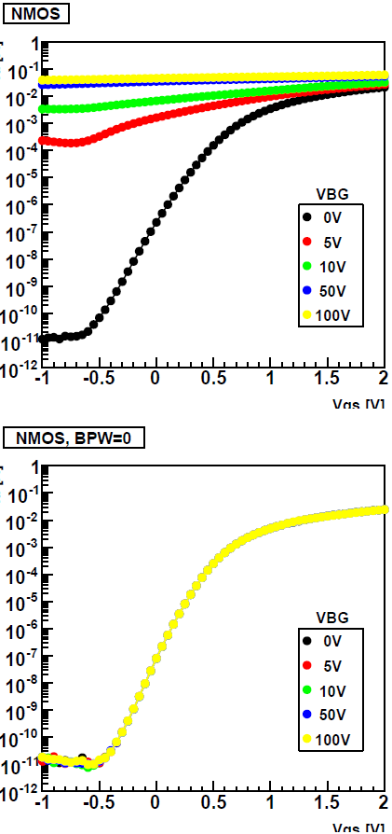
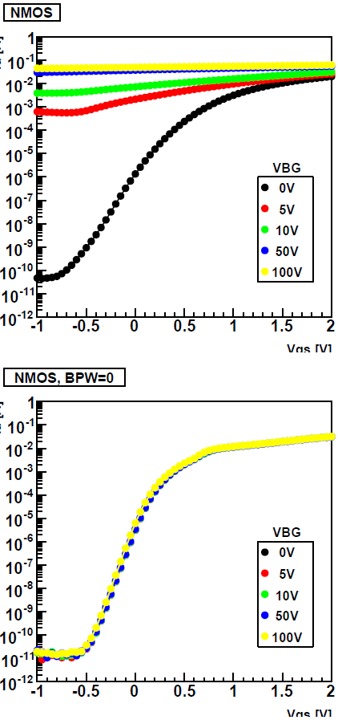
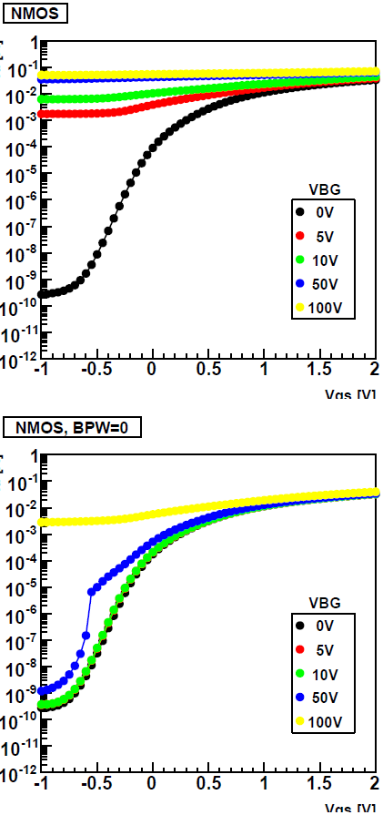
Radiation Effects to NMOS (Co irradiation)
(top plots) Tr I-V is distorted as Vback is raised, if no BPW
(bottom) Tr I-V is unchanged up to Vback=100V, if BPW=0V
w/o BPW
0.20 kGy
2.0 kGy
5.0 kGy
22 kGy
Vgs [V]
Vgs [V]
w/ BPW
=0V
preliminary
Vgs [V]
Vgs [V]
Vgs [V]
start to deviate
distortion

Slide 22
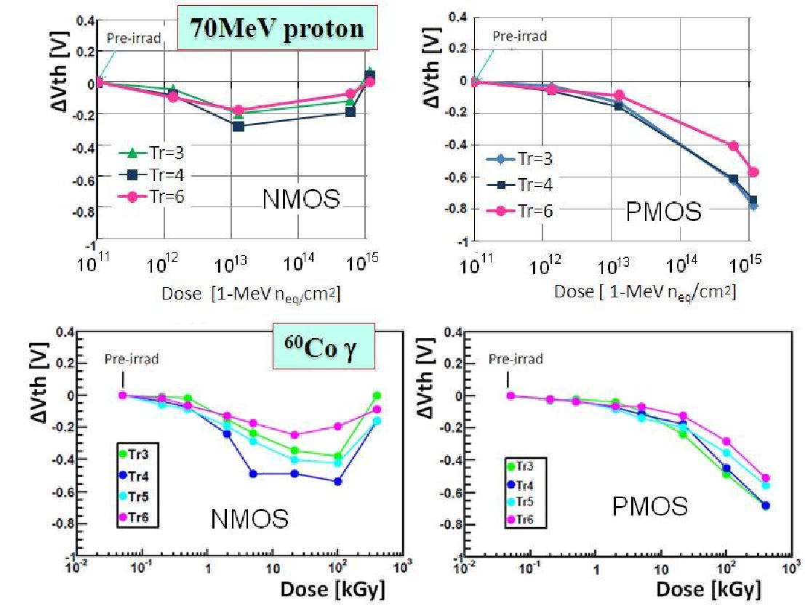
Vth shifts by 70-MeV protons and ⁶⁰Co
pre-irrad
70-MeV protons
Tr3-5: t_{OX}=7.0nm
Tr6: t_{OX}=4.5nm
⁶⁰Co γ
shifts by protons and Co are similar : rebound in NMOS
Main reason for the threshold shifts is charge states trapped in oxide, mainly in BOX (estimated from TCAD simulation).
The thresholds shifts are recoverable by annealing (confirmed for samples irradiated to 2 kGy X-ray)

Slide 23
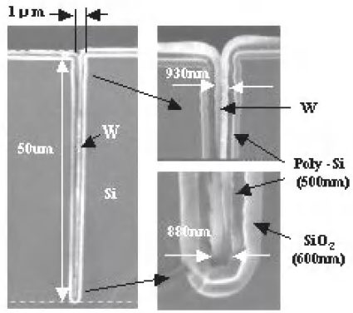
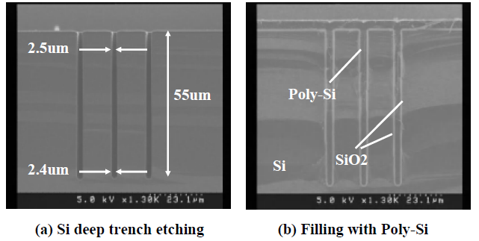
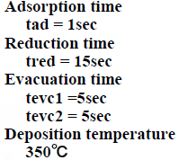
3D: T-Micro
Tohoku-Micro Tec Co.
VIA first
Koyanagi group has technologies for 3D
Via, ConC/ConW self alignment, μ-bond, adhesive injection

Slide 24
3D: μ-Bond Process Flow for SOIPIX

Slide 25
Wafer Bonding by μ-Bumps
Metal bumps (In/Au) are created by lift-off method
Good mechanical bonding is provided by adhesive
SEM for test SOI chips

Slide 26
Bonded SOI

Slide 27
Schematic of μ-bump

Slide 28
μ-Bumps

Slide 29
Summary
SOI monolithic pixel devices, INTPIX and CNTPIX mainly, are developed successfully showing ingenious feature in detecting visible/IR light and X-rays.
Buried p-Well is a technological breakthrough in suppressing the back-gate effect.
Further R&D is on-going including
Thinning by TAIKO process
Larger INTPIX and CNTPIX detectors
Charged particle detection
Radiation effect study
Vertical (3D) integration is one of the key technologies for further SOI pixel detector developments.
We are operating SOI MPW run twice per year. We welcome more and more participants to make the technology further established.

Slide 30
Adhesive injection

Slide 31
BPW designs for on-pixel electronics
Region 4
(no BPW)
Region 2
BPW=yellowish
1
2
3
4
Region 8
5
6
7
8
Region 5
p+
p+
Regions 1-3,7 ：1p readout
No BPW in R4 and R8 (under transistors)

